Slide 1
Milestone 2
Tag your it
Kevin Goldman, Thomas Gregory, Julien Spence, Casey Pastella, Dwayne Leonard

Slide 2
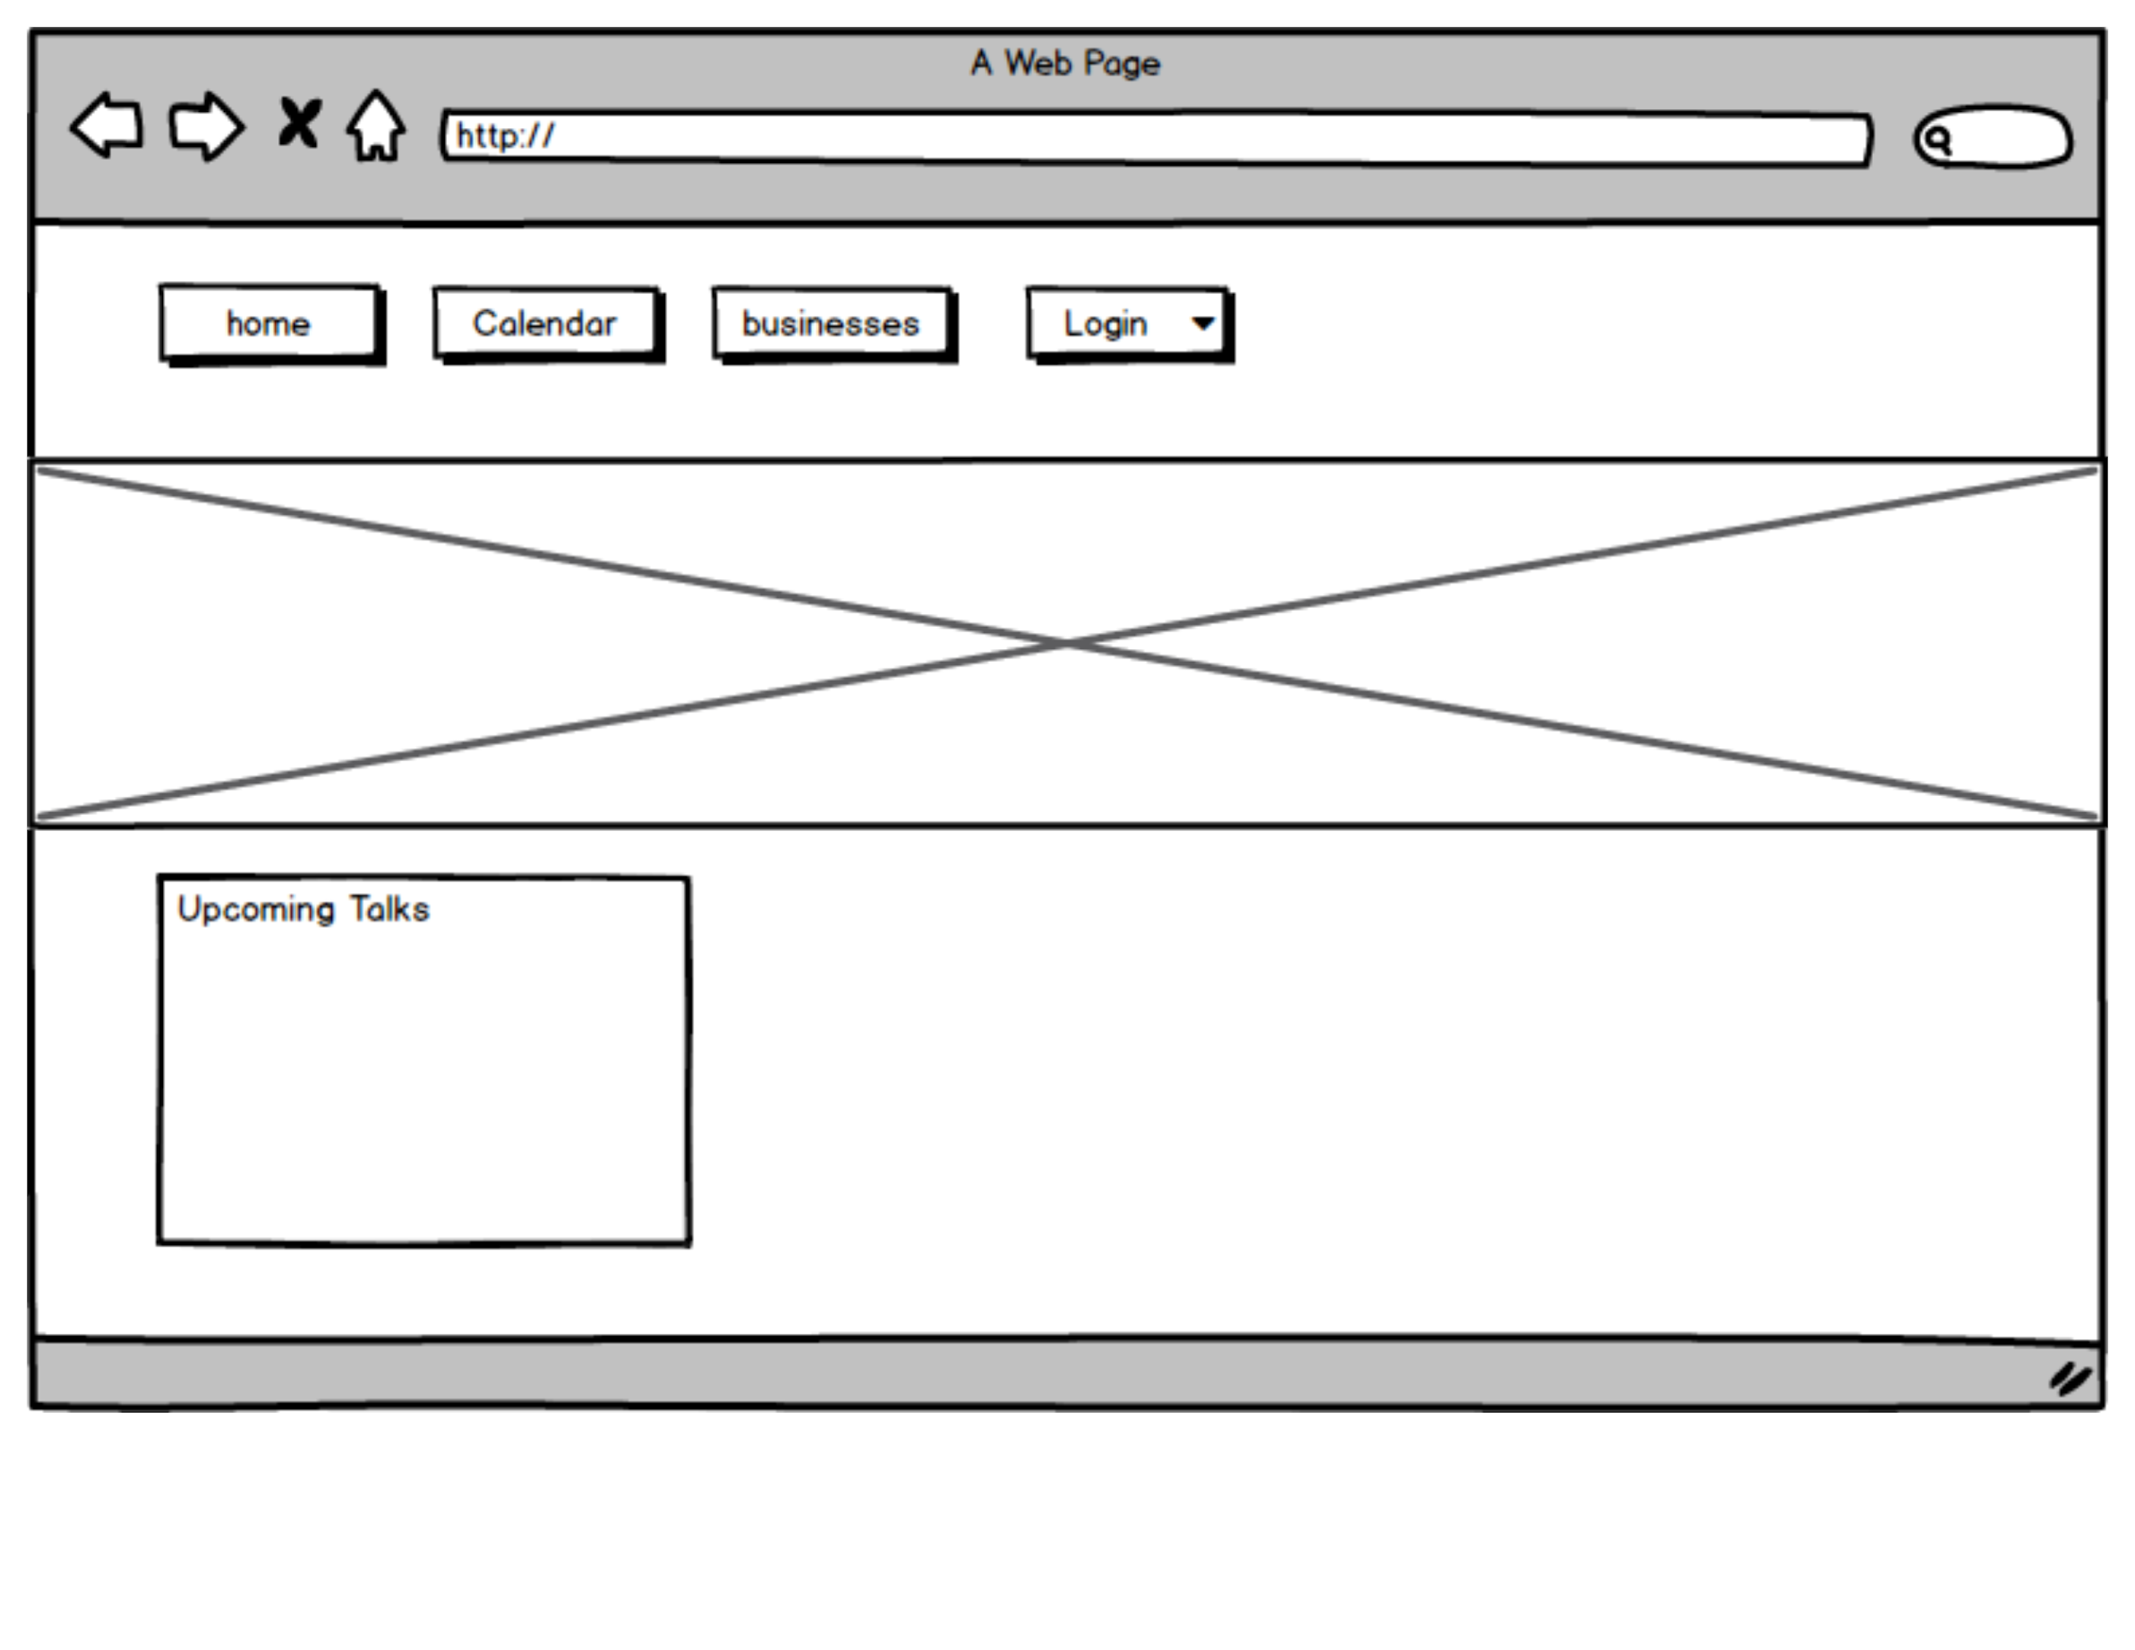
Desktop 1

Slide 3
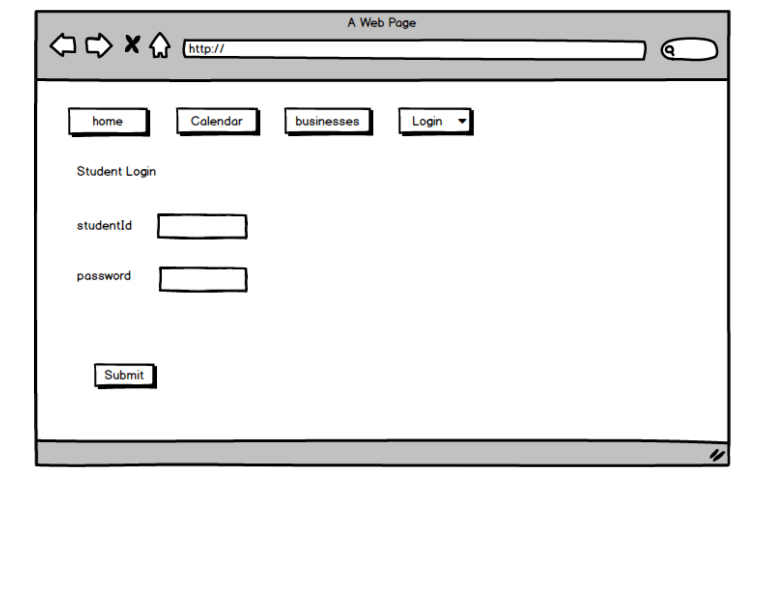
Desktop 2

Slide 4
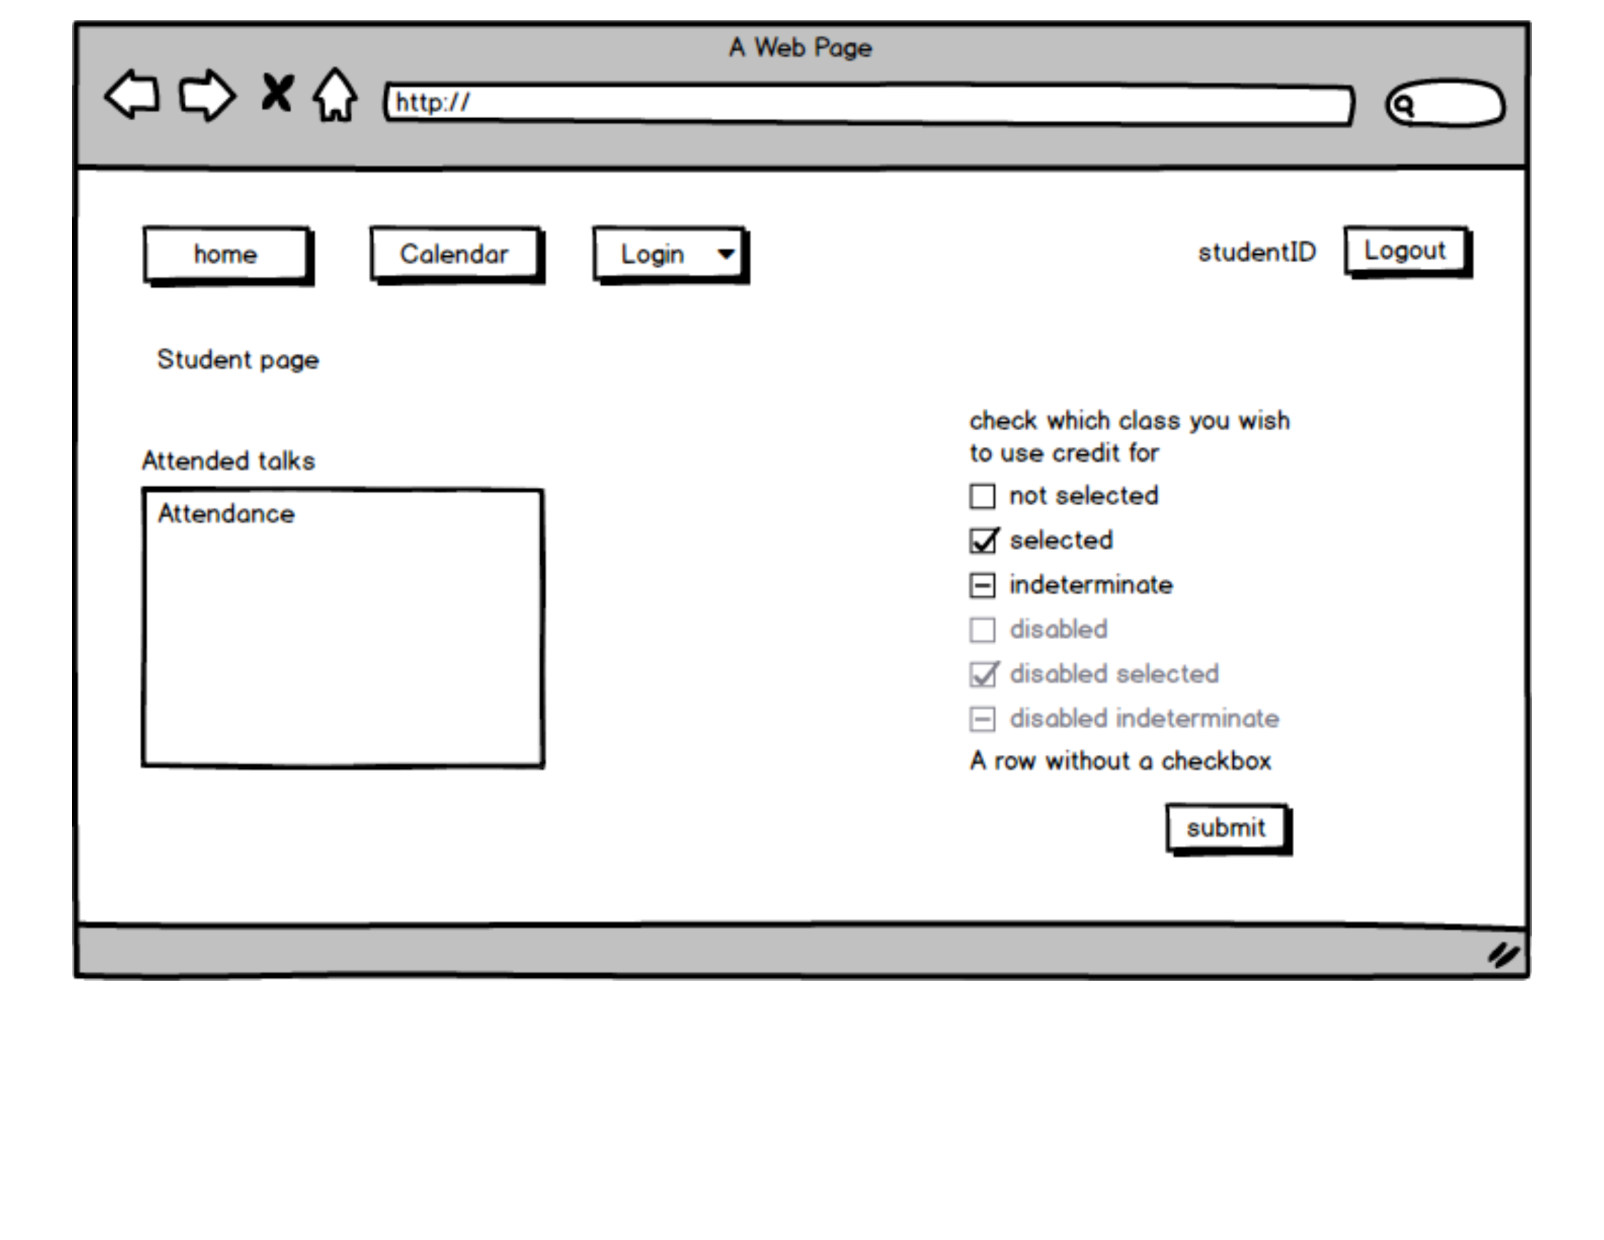
Desktop 3

Slide 5
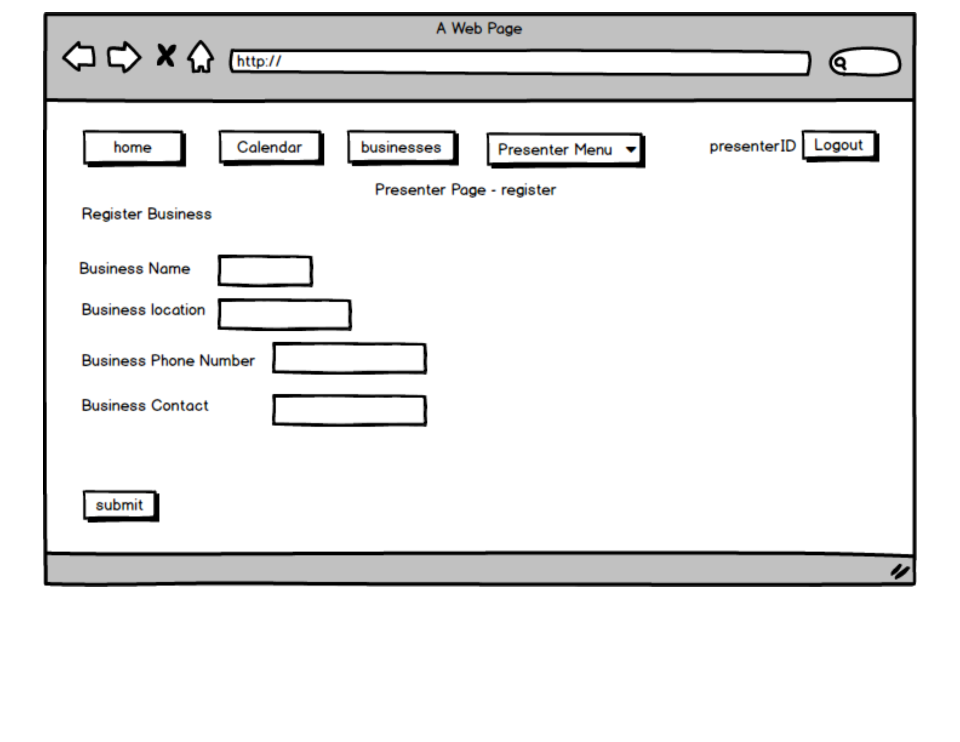
Desktop 4

Slide 6
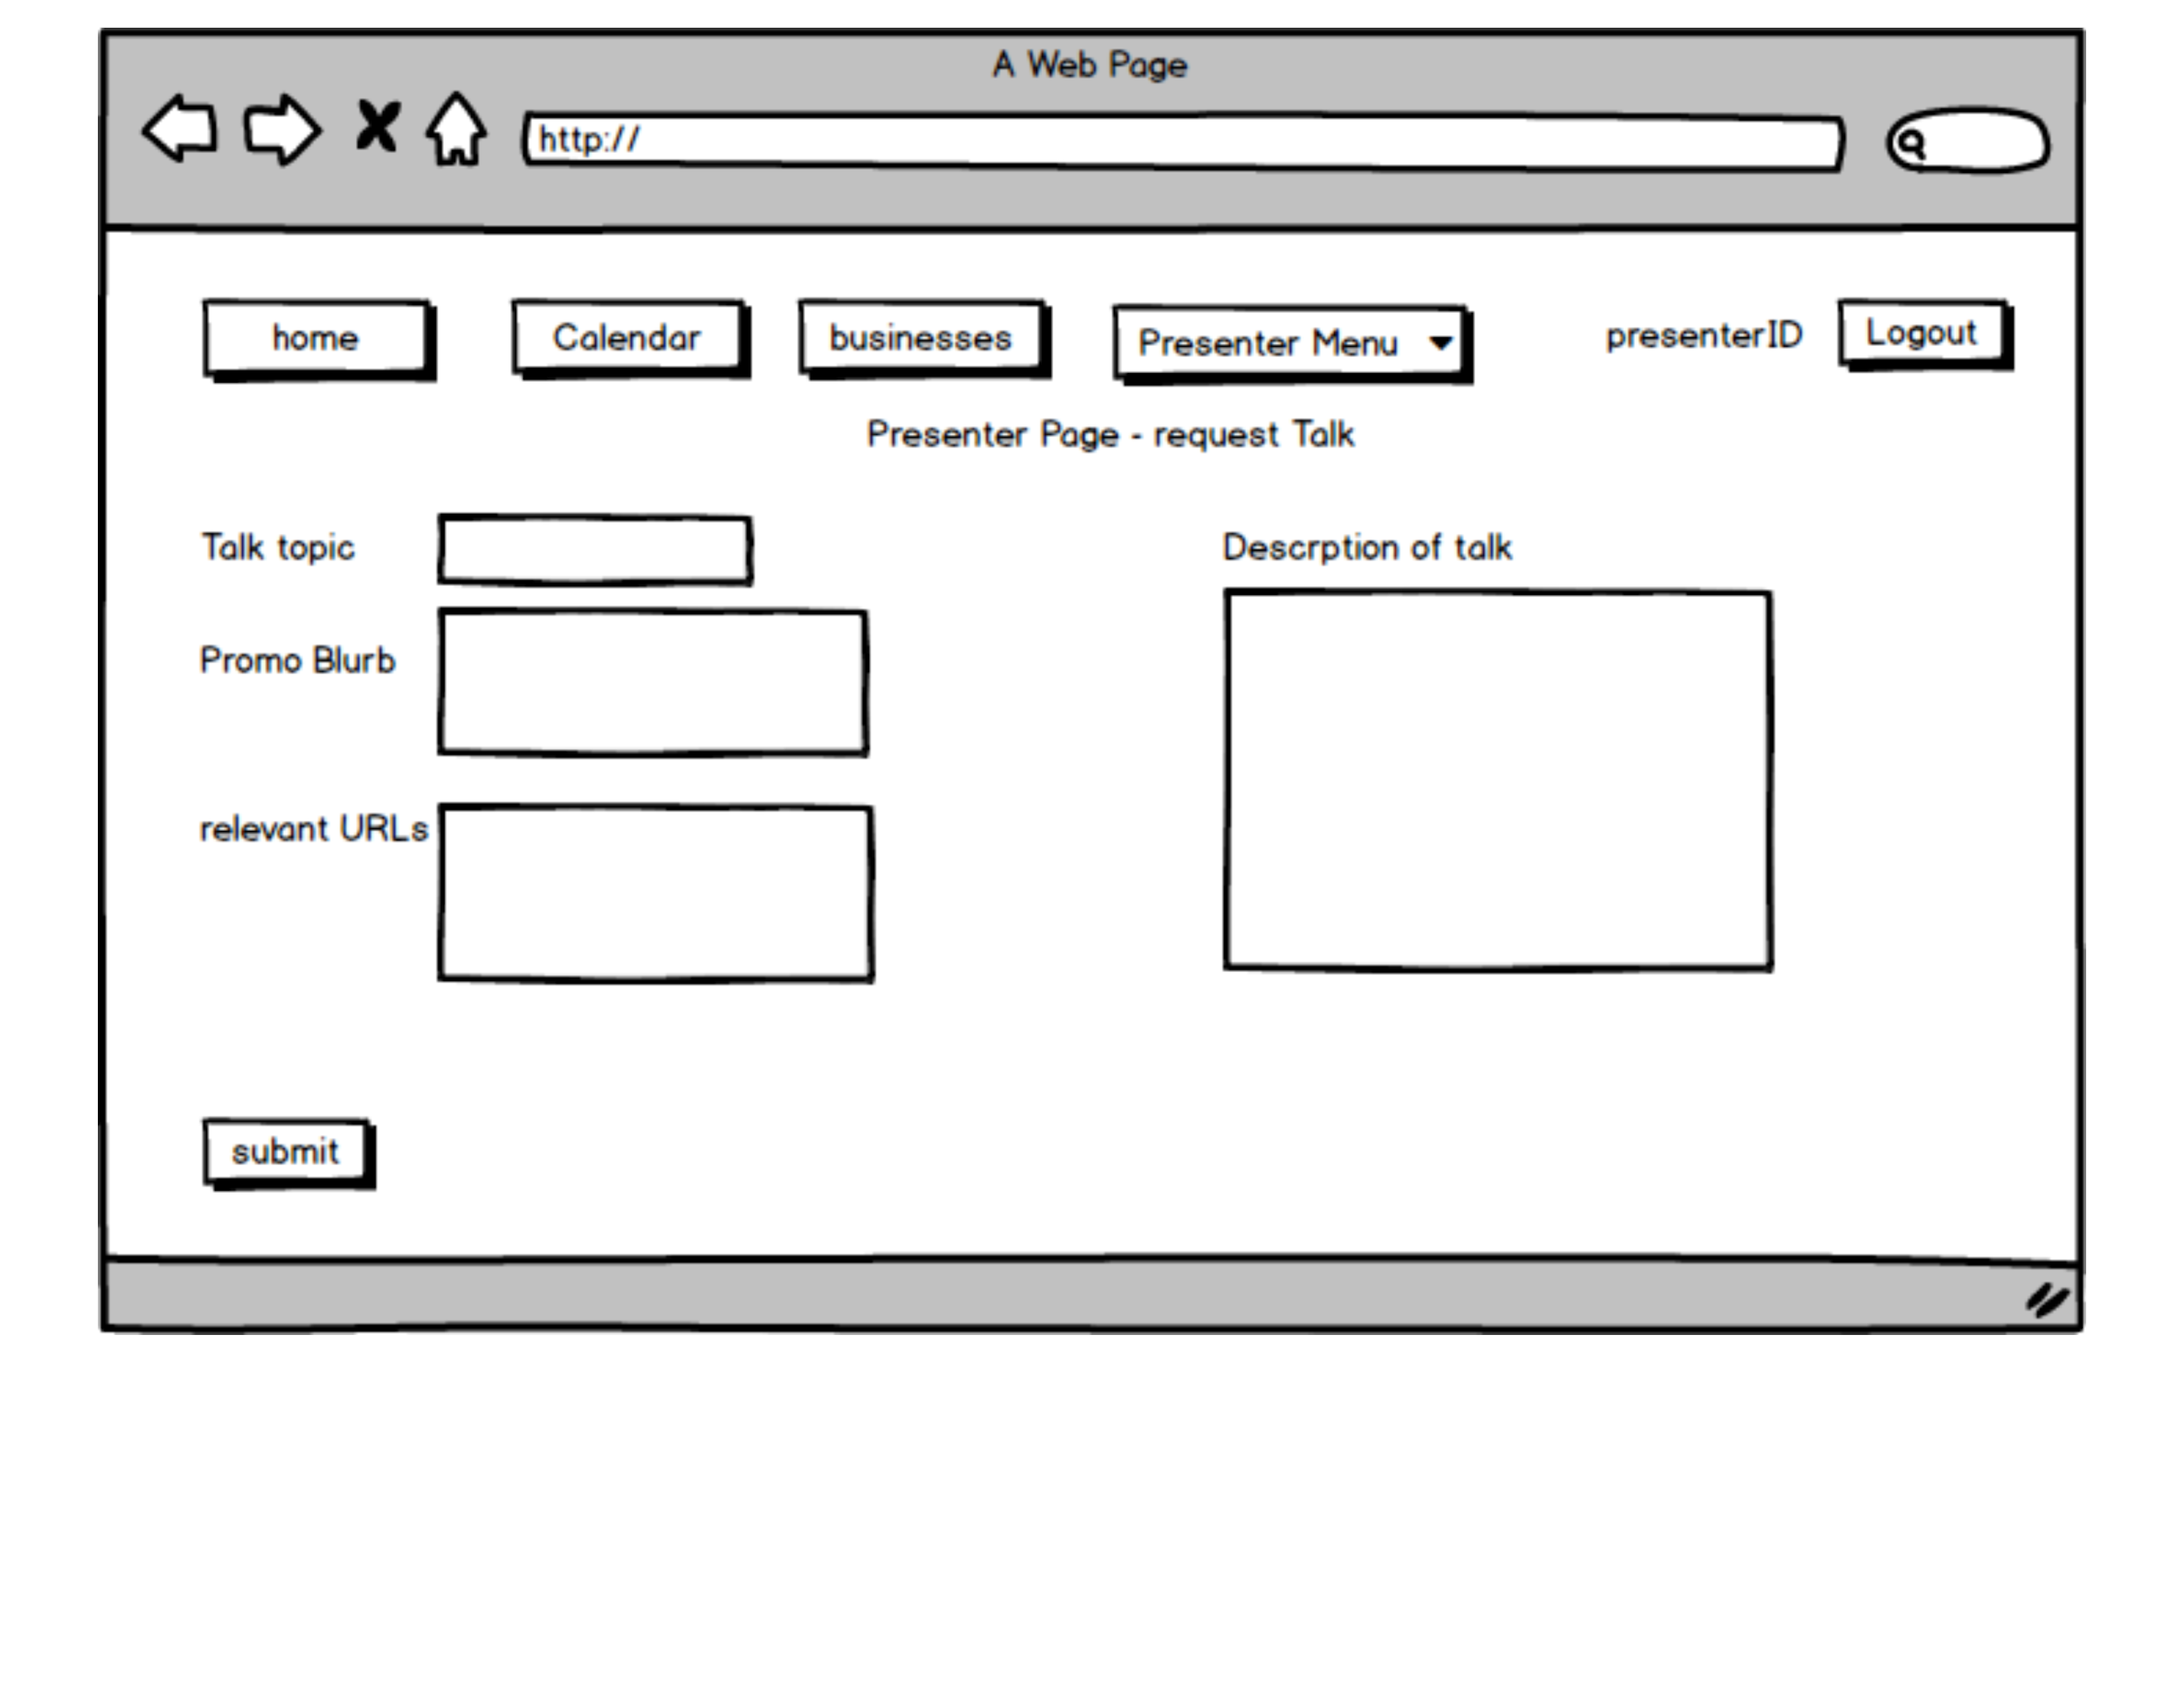
Desktop 5

Slide 7
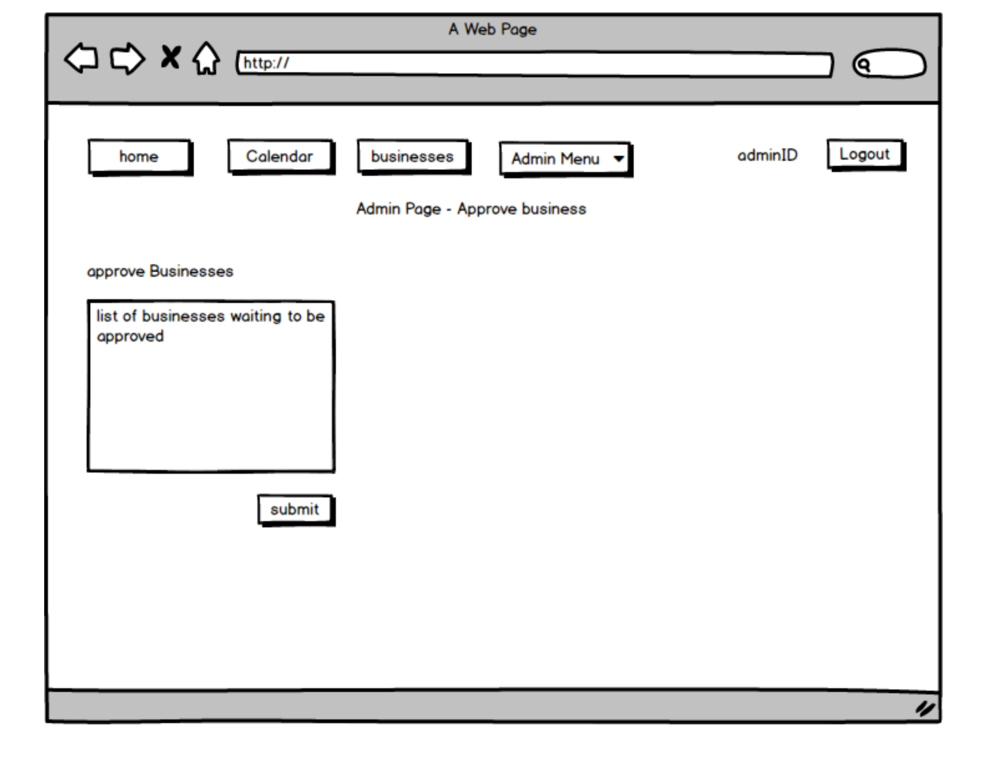
Desktop 6

Slide 8
Desktop 7

Slide 9
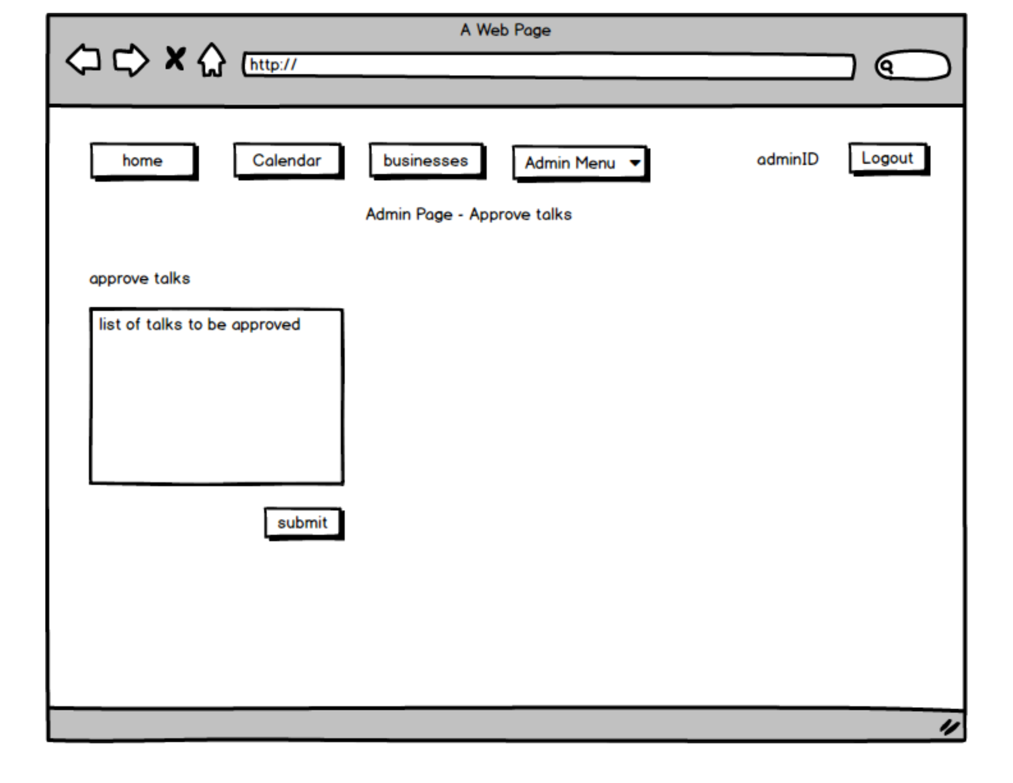
Desktop 8

Slide 10
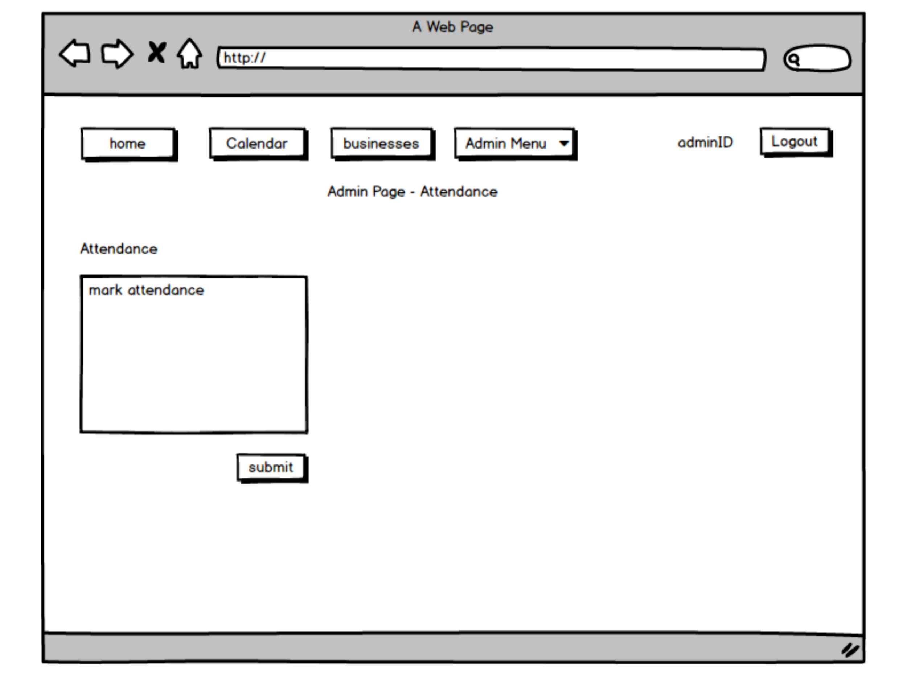
Desktop 9

Slide 11
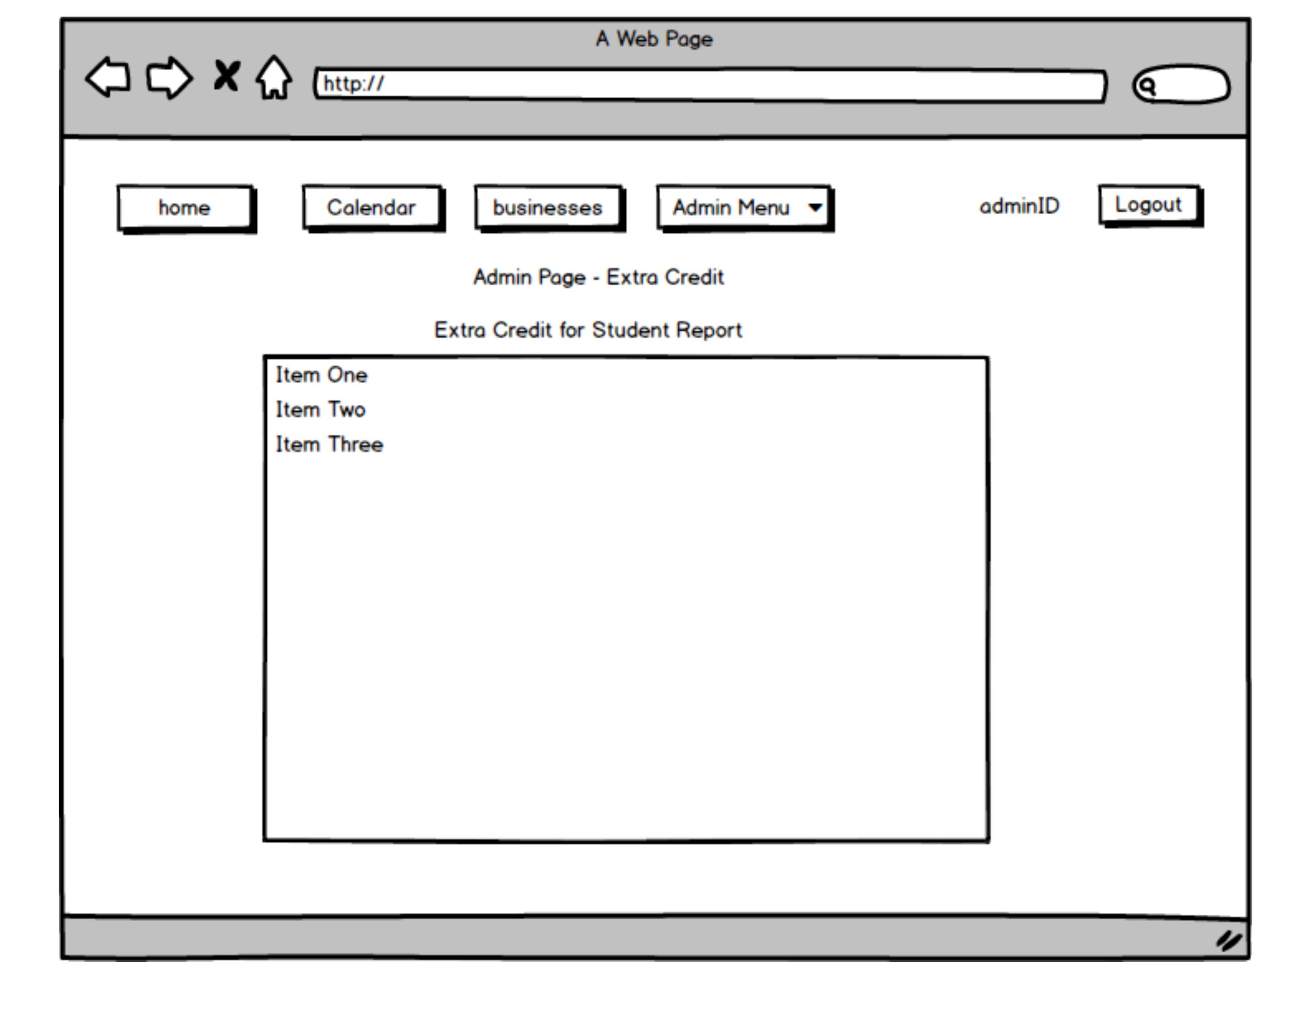
Desktop 10

Slide 12

Desktop 11

Slide 13

Desktop 12

Slide 14
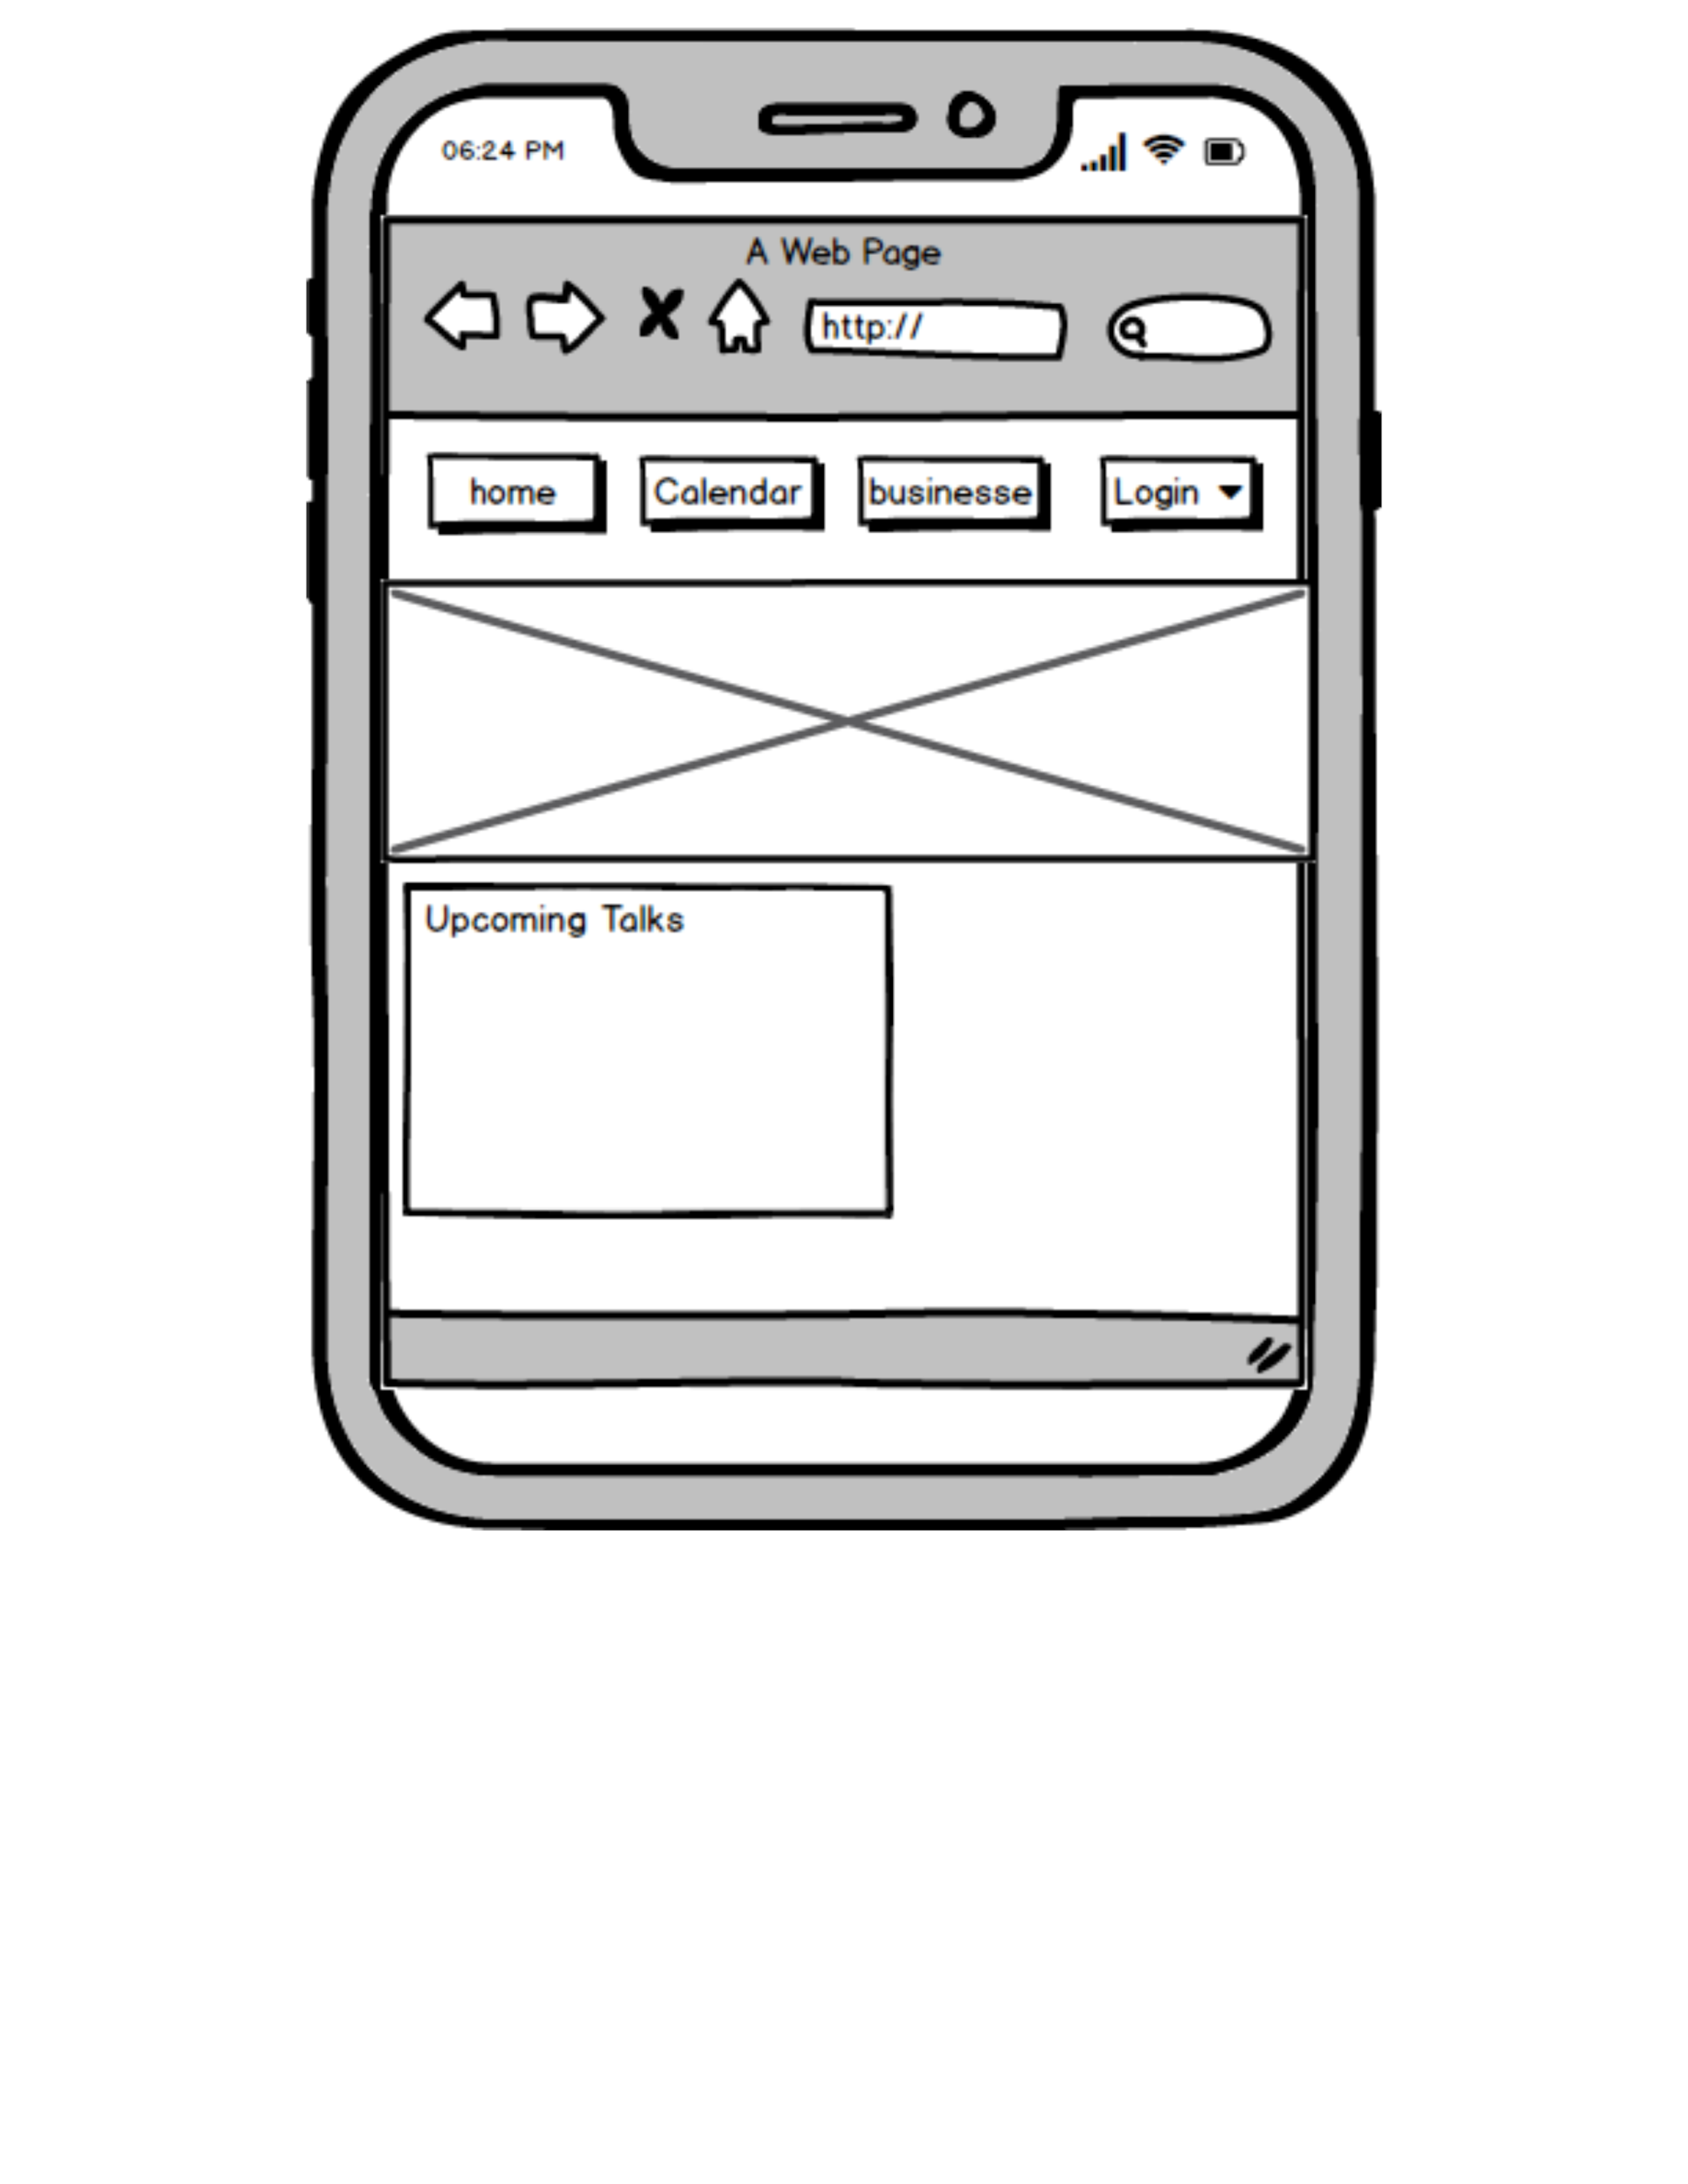
Mobile 1

Slide 15
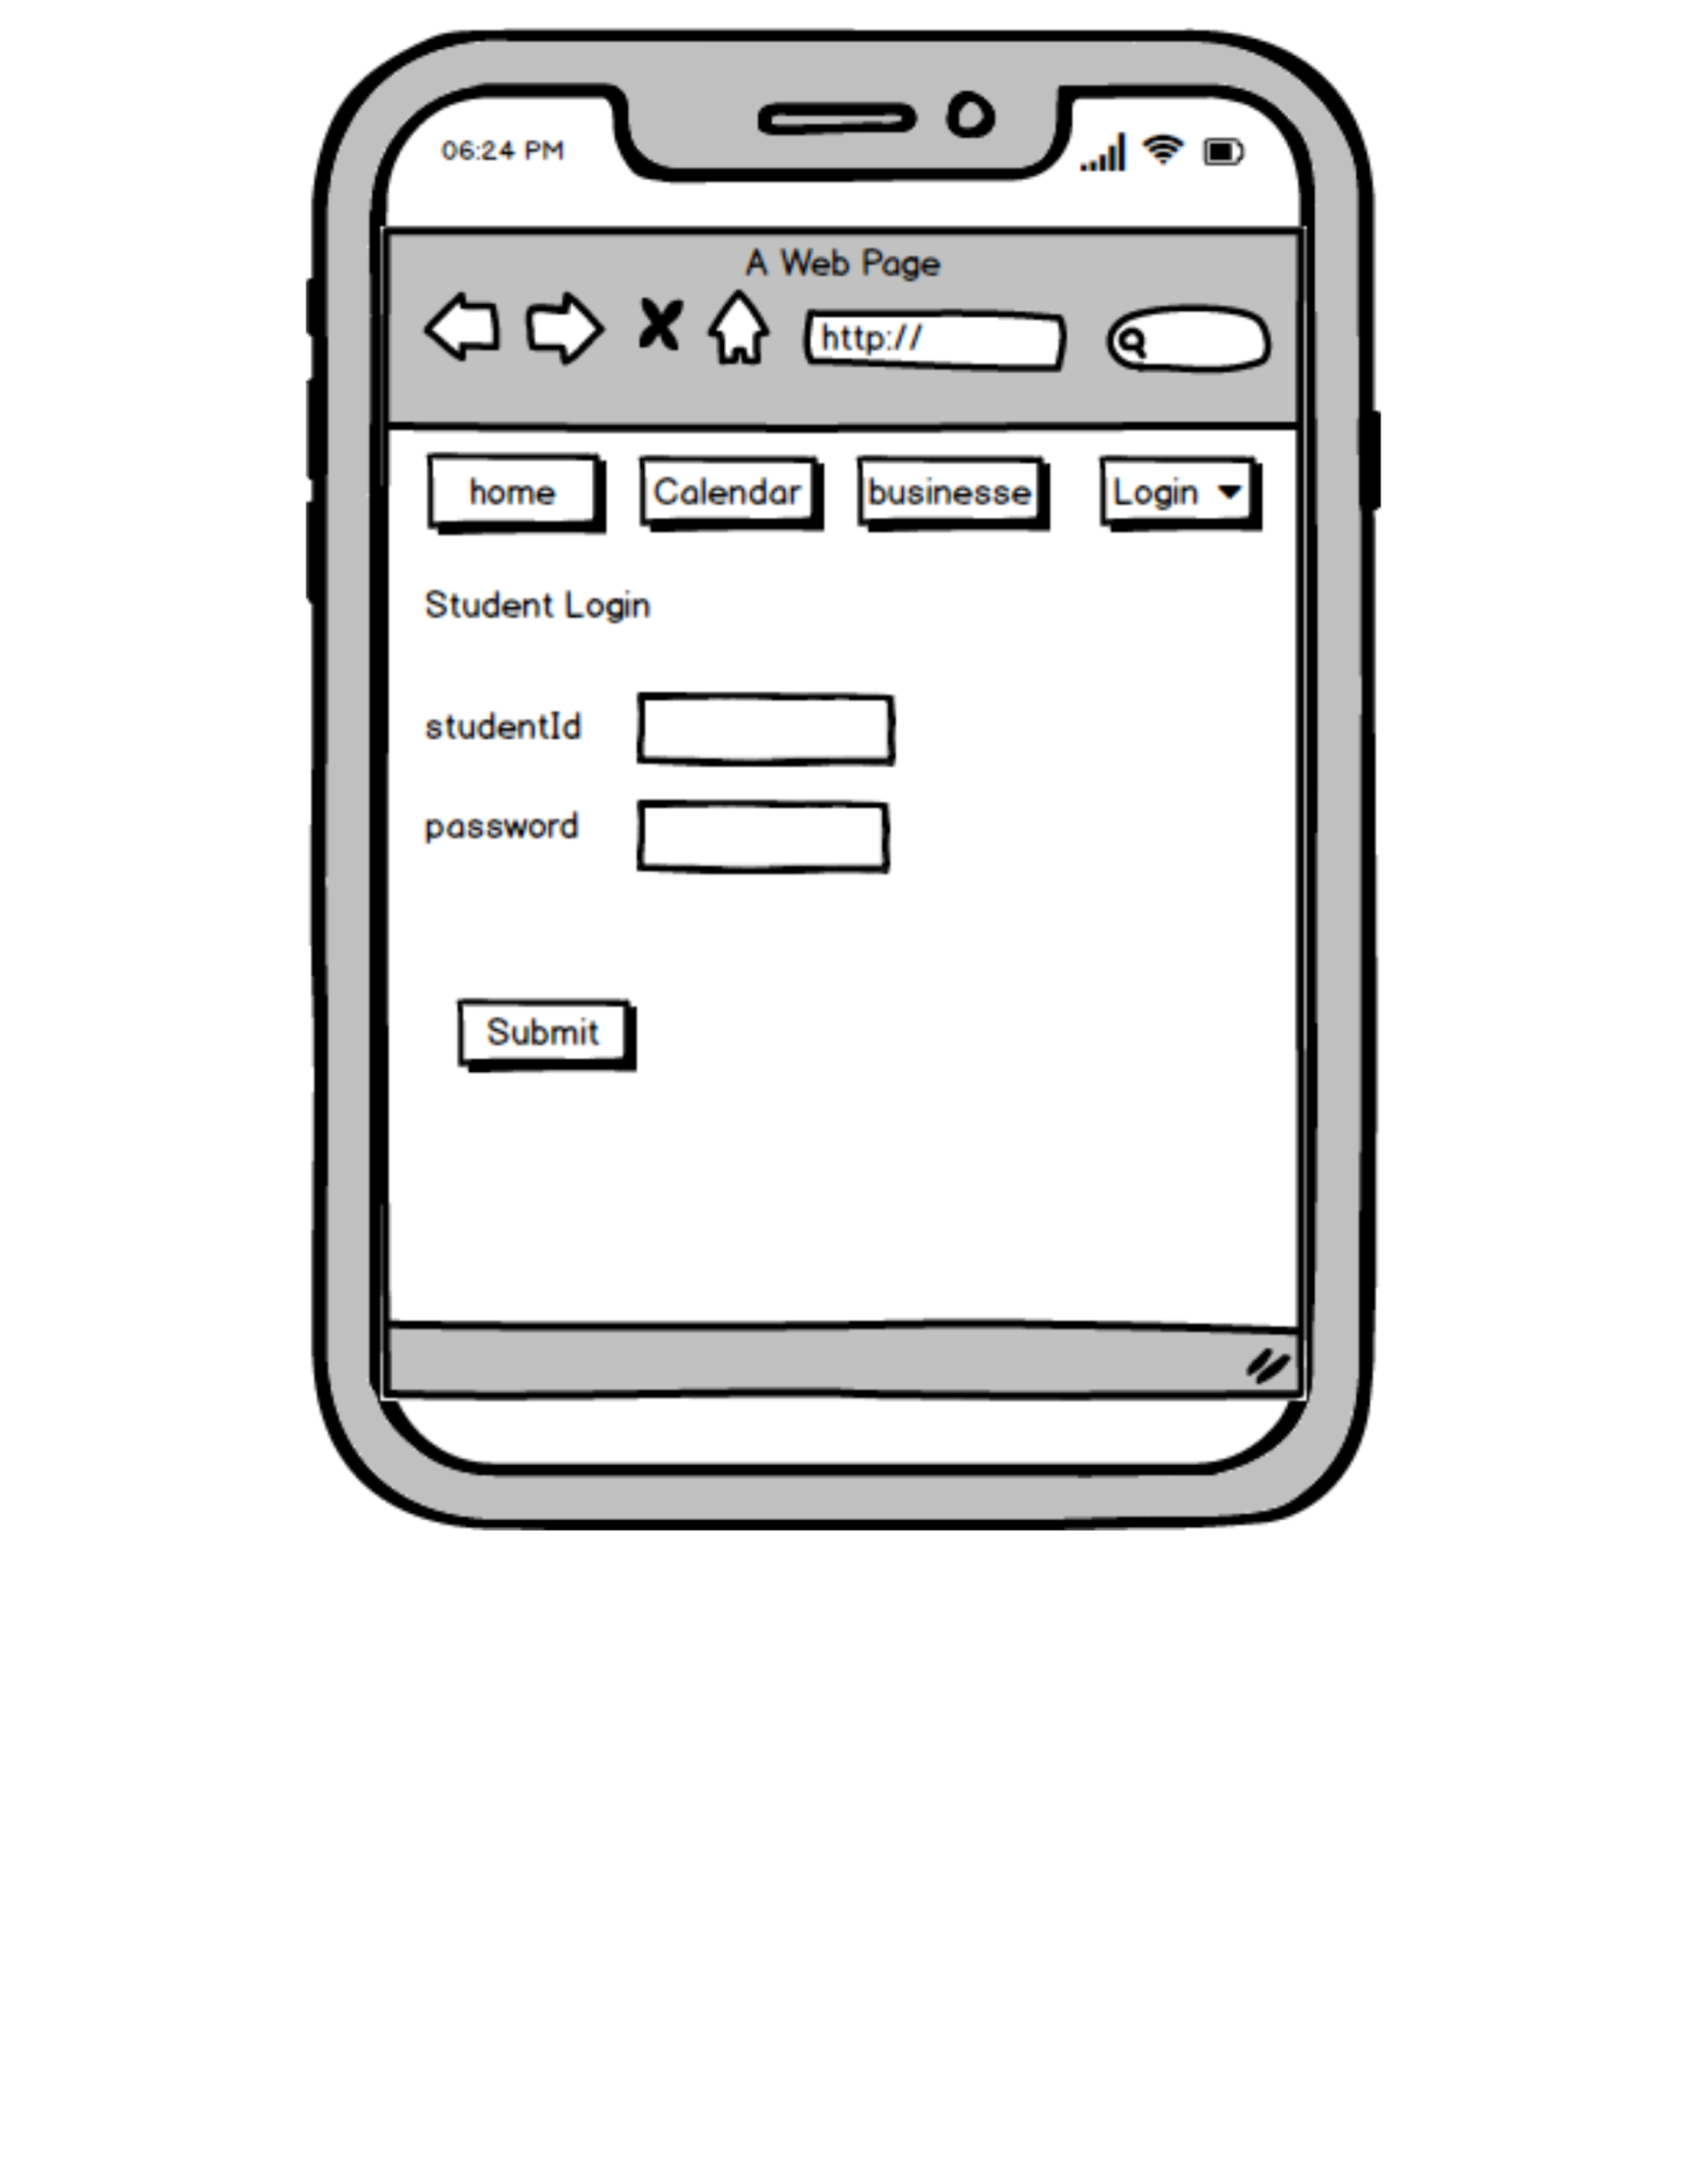
Mobile 2

Slide 16
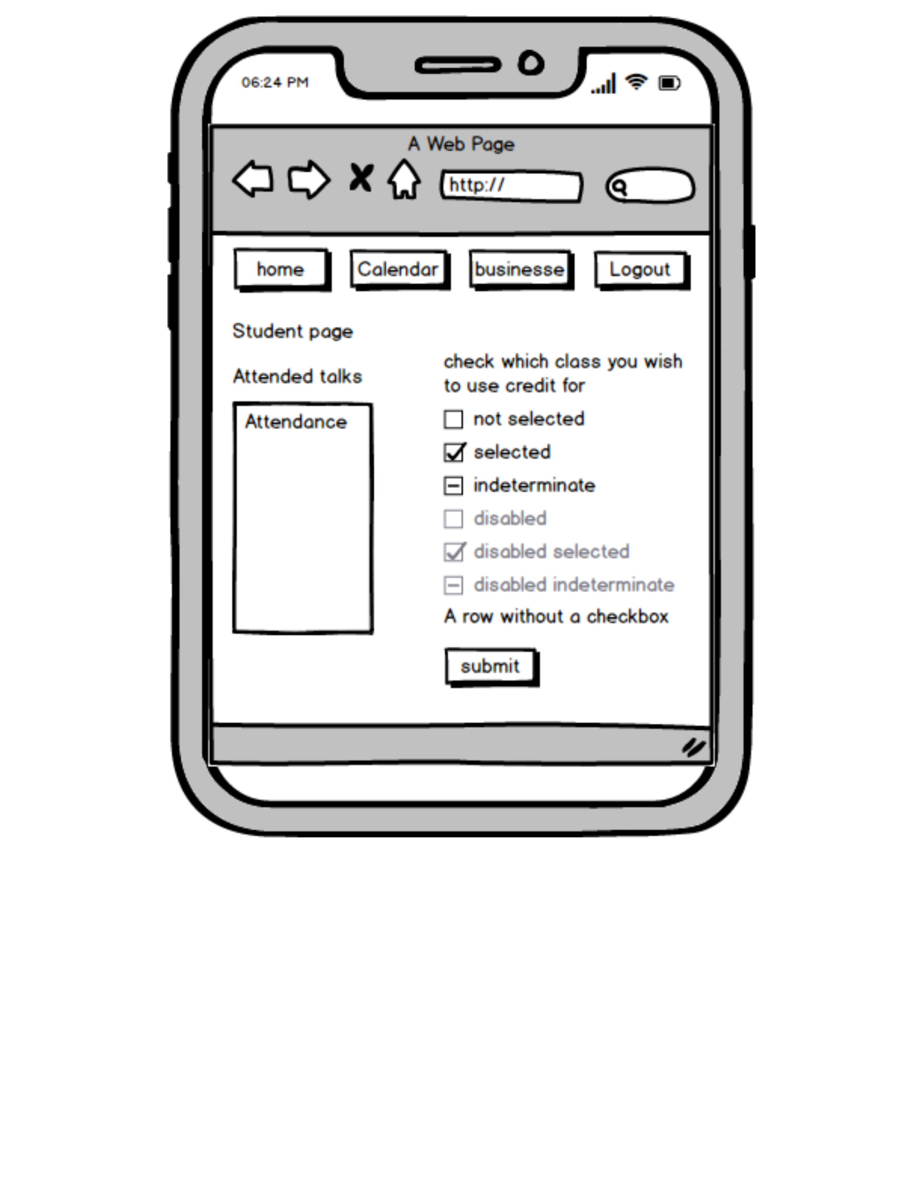
Mobile 3

Slide 17
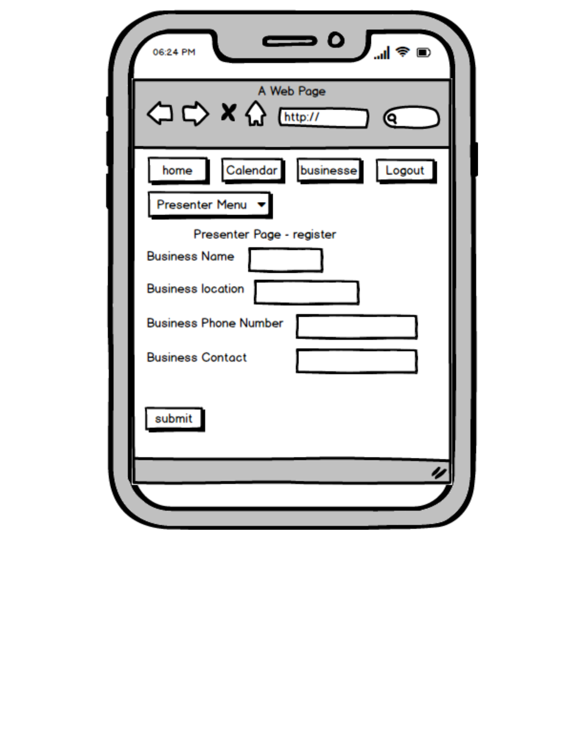
Mobile 4

Slide 18
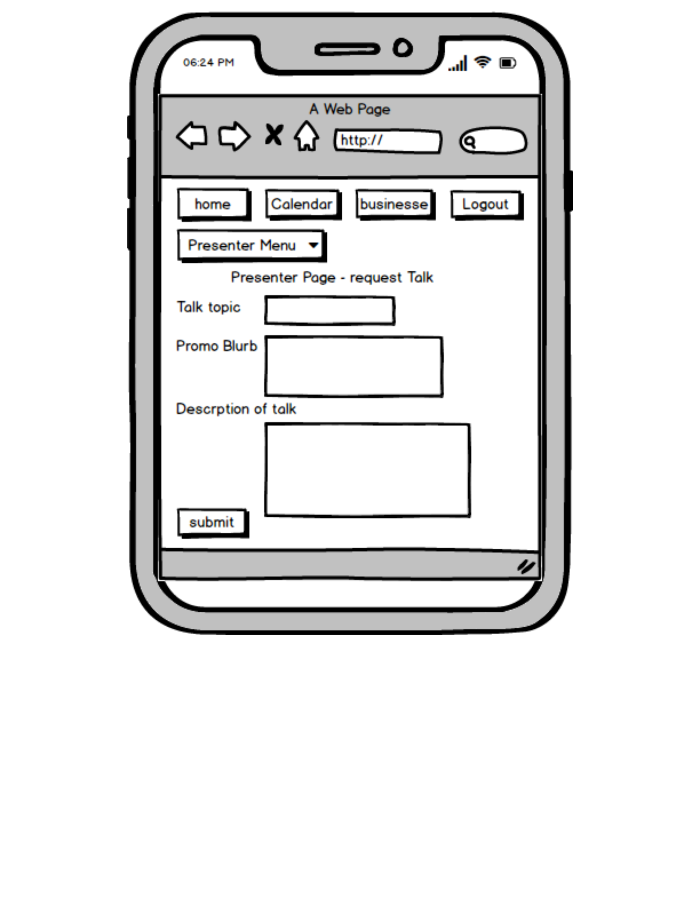
Mobile 5

Slide 19
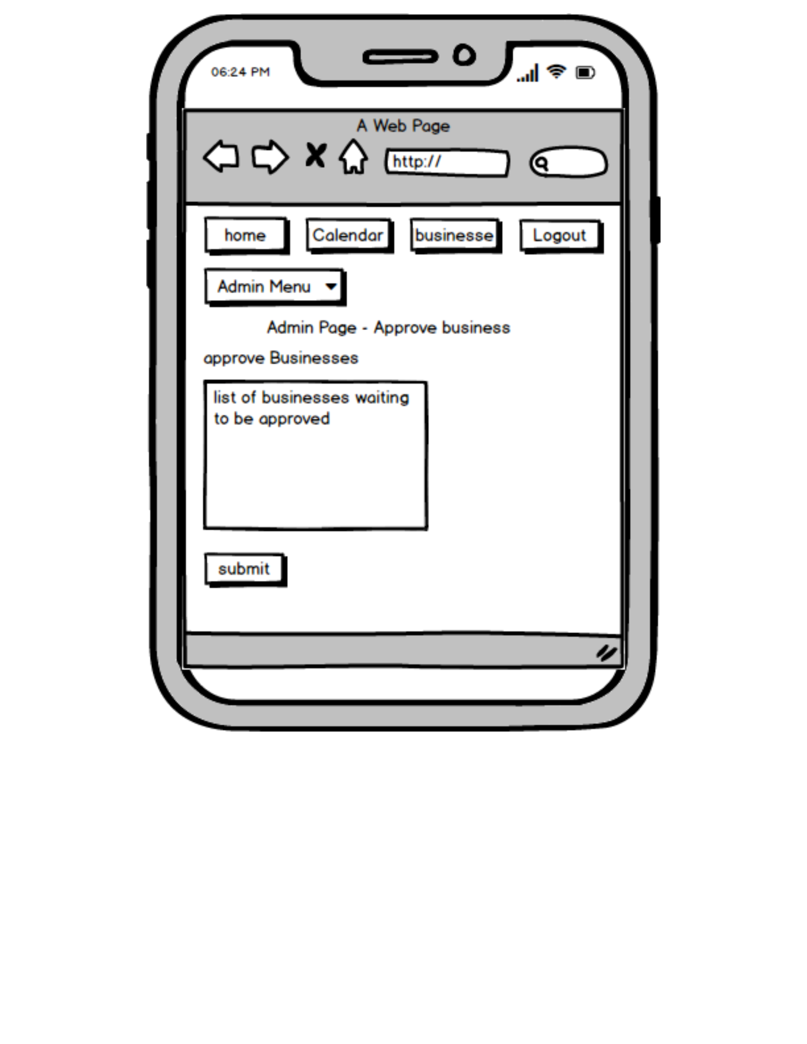
Mobile 6

Slide 20
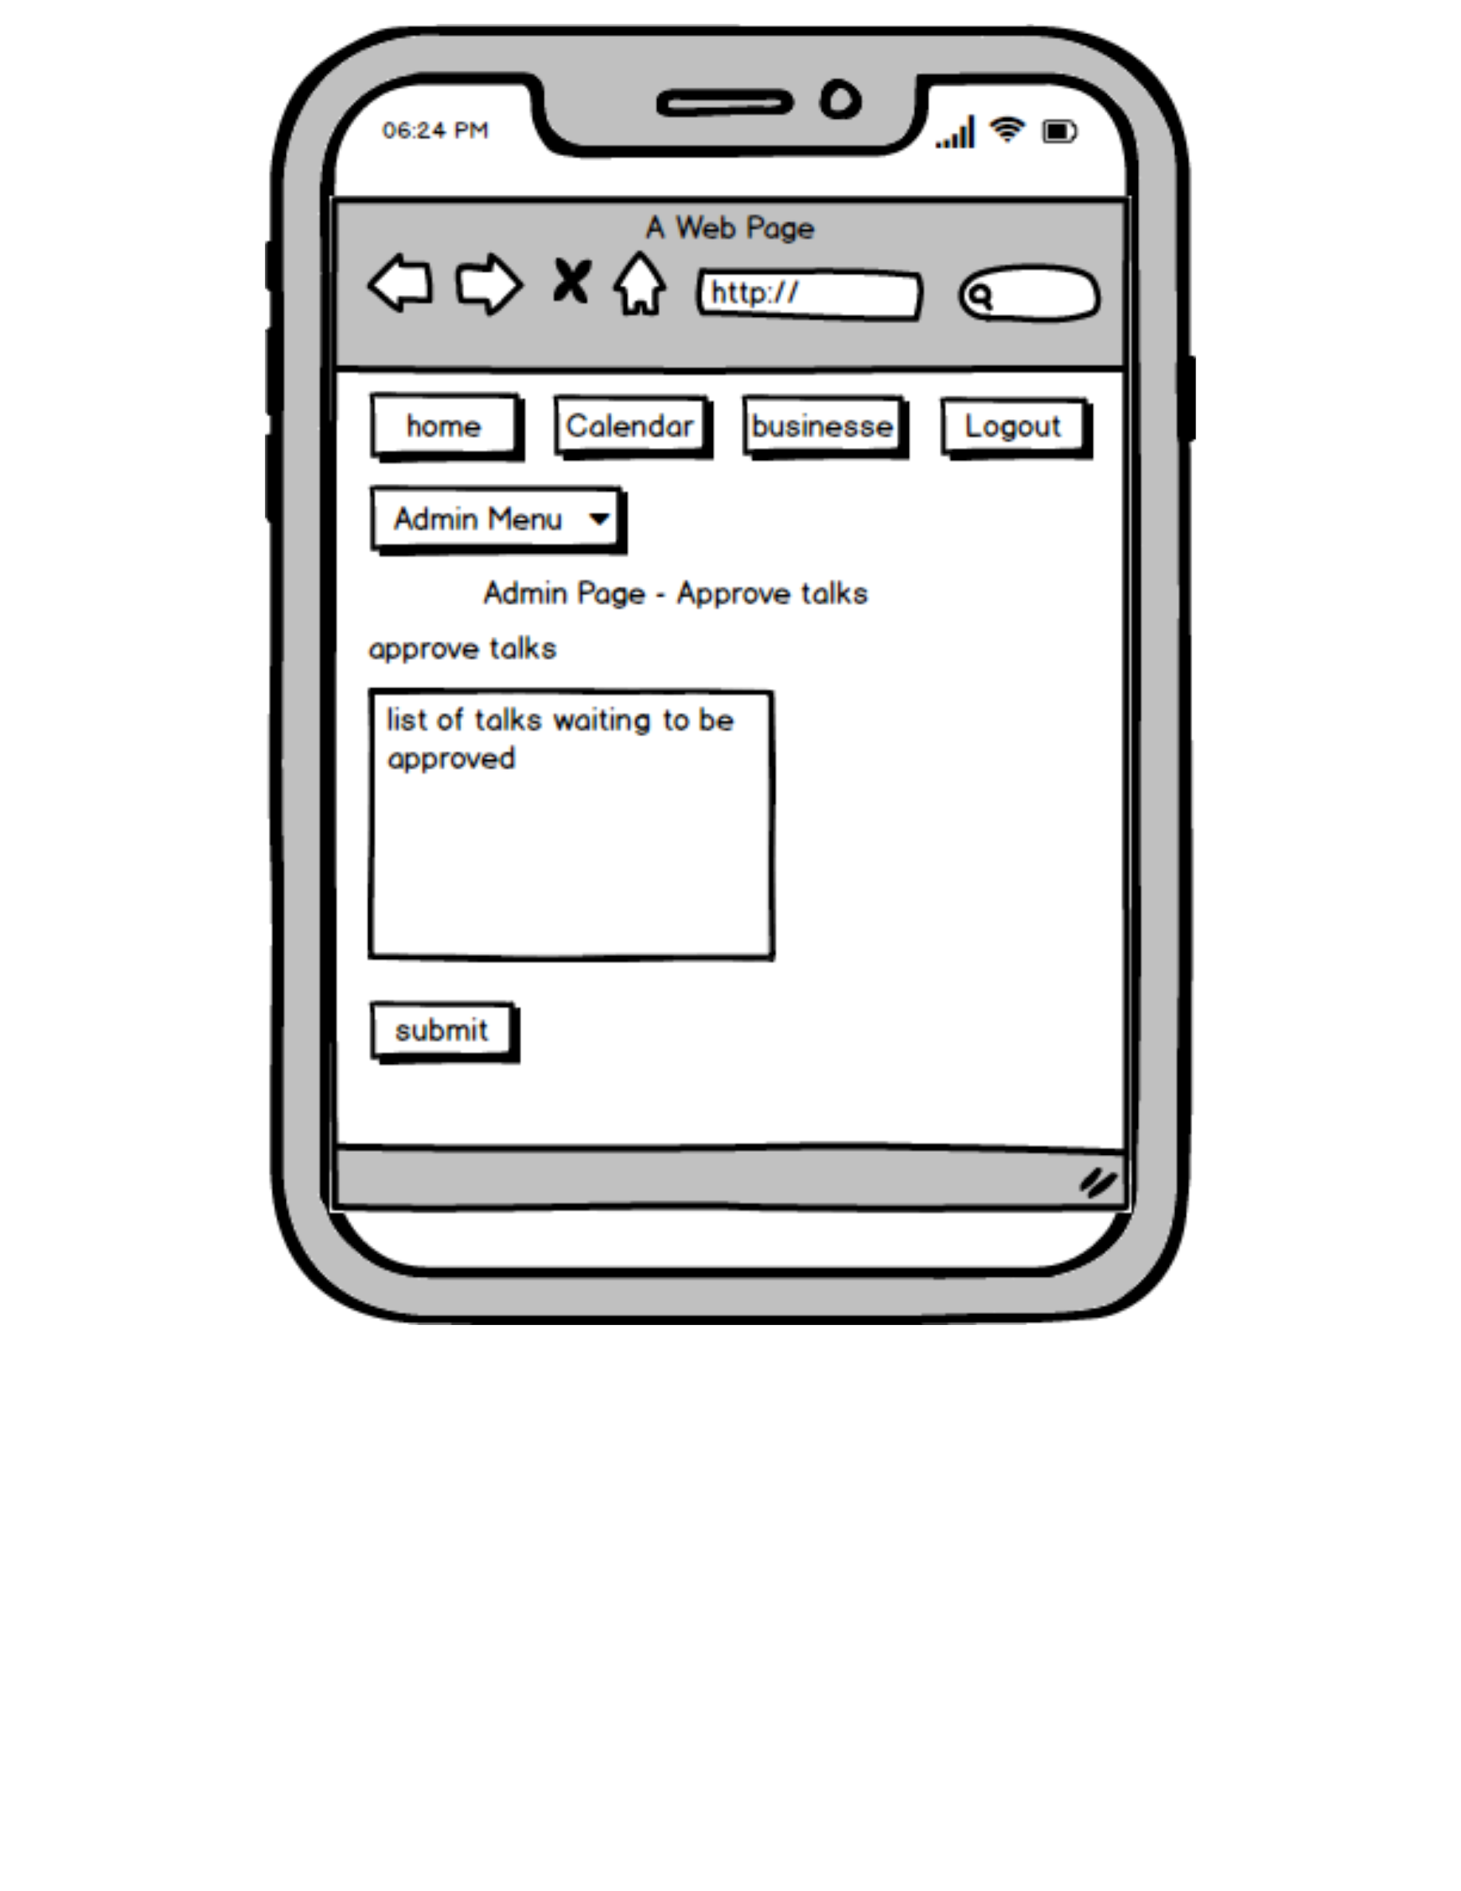
Mobile 7

Slide 21
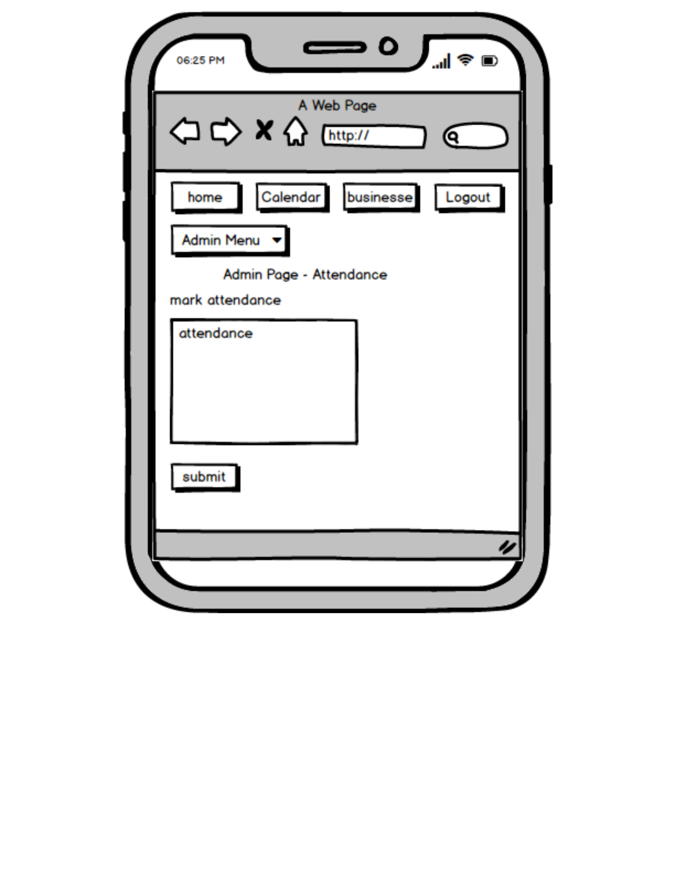
Mobile 8

Slide 22
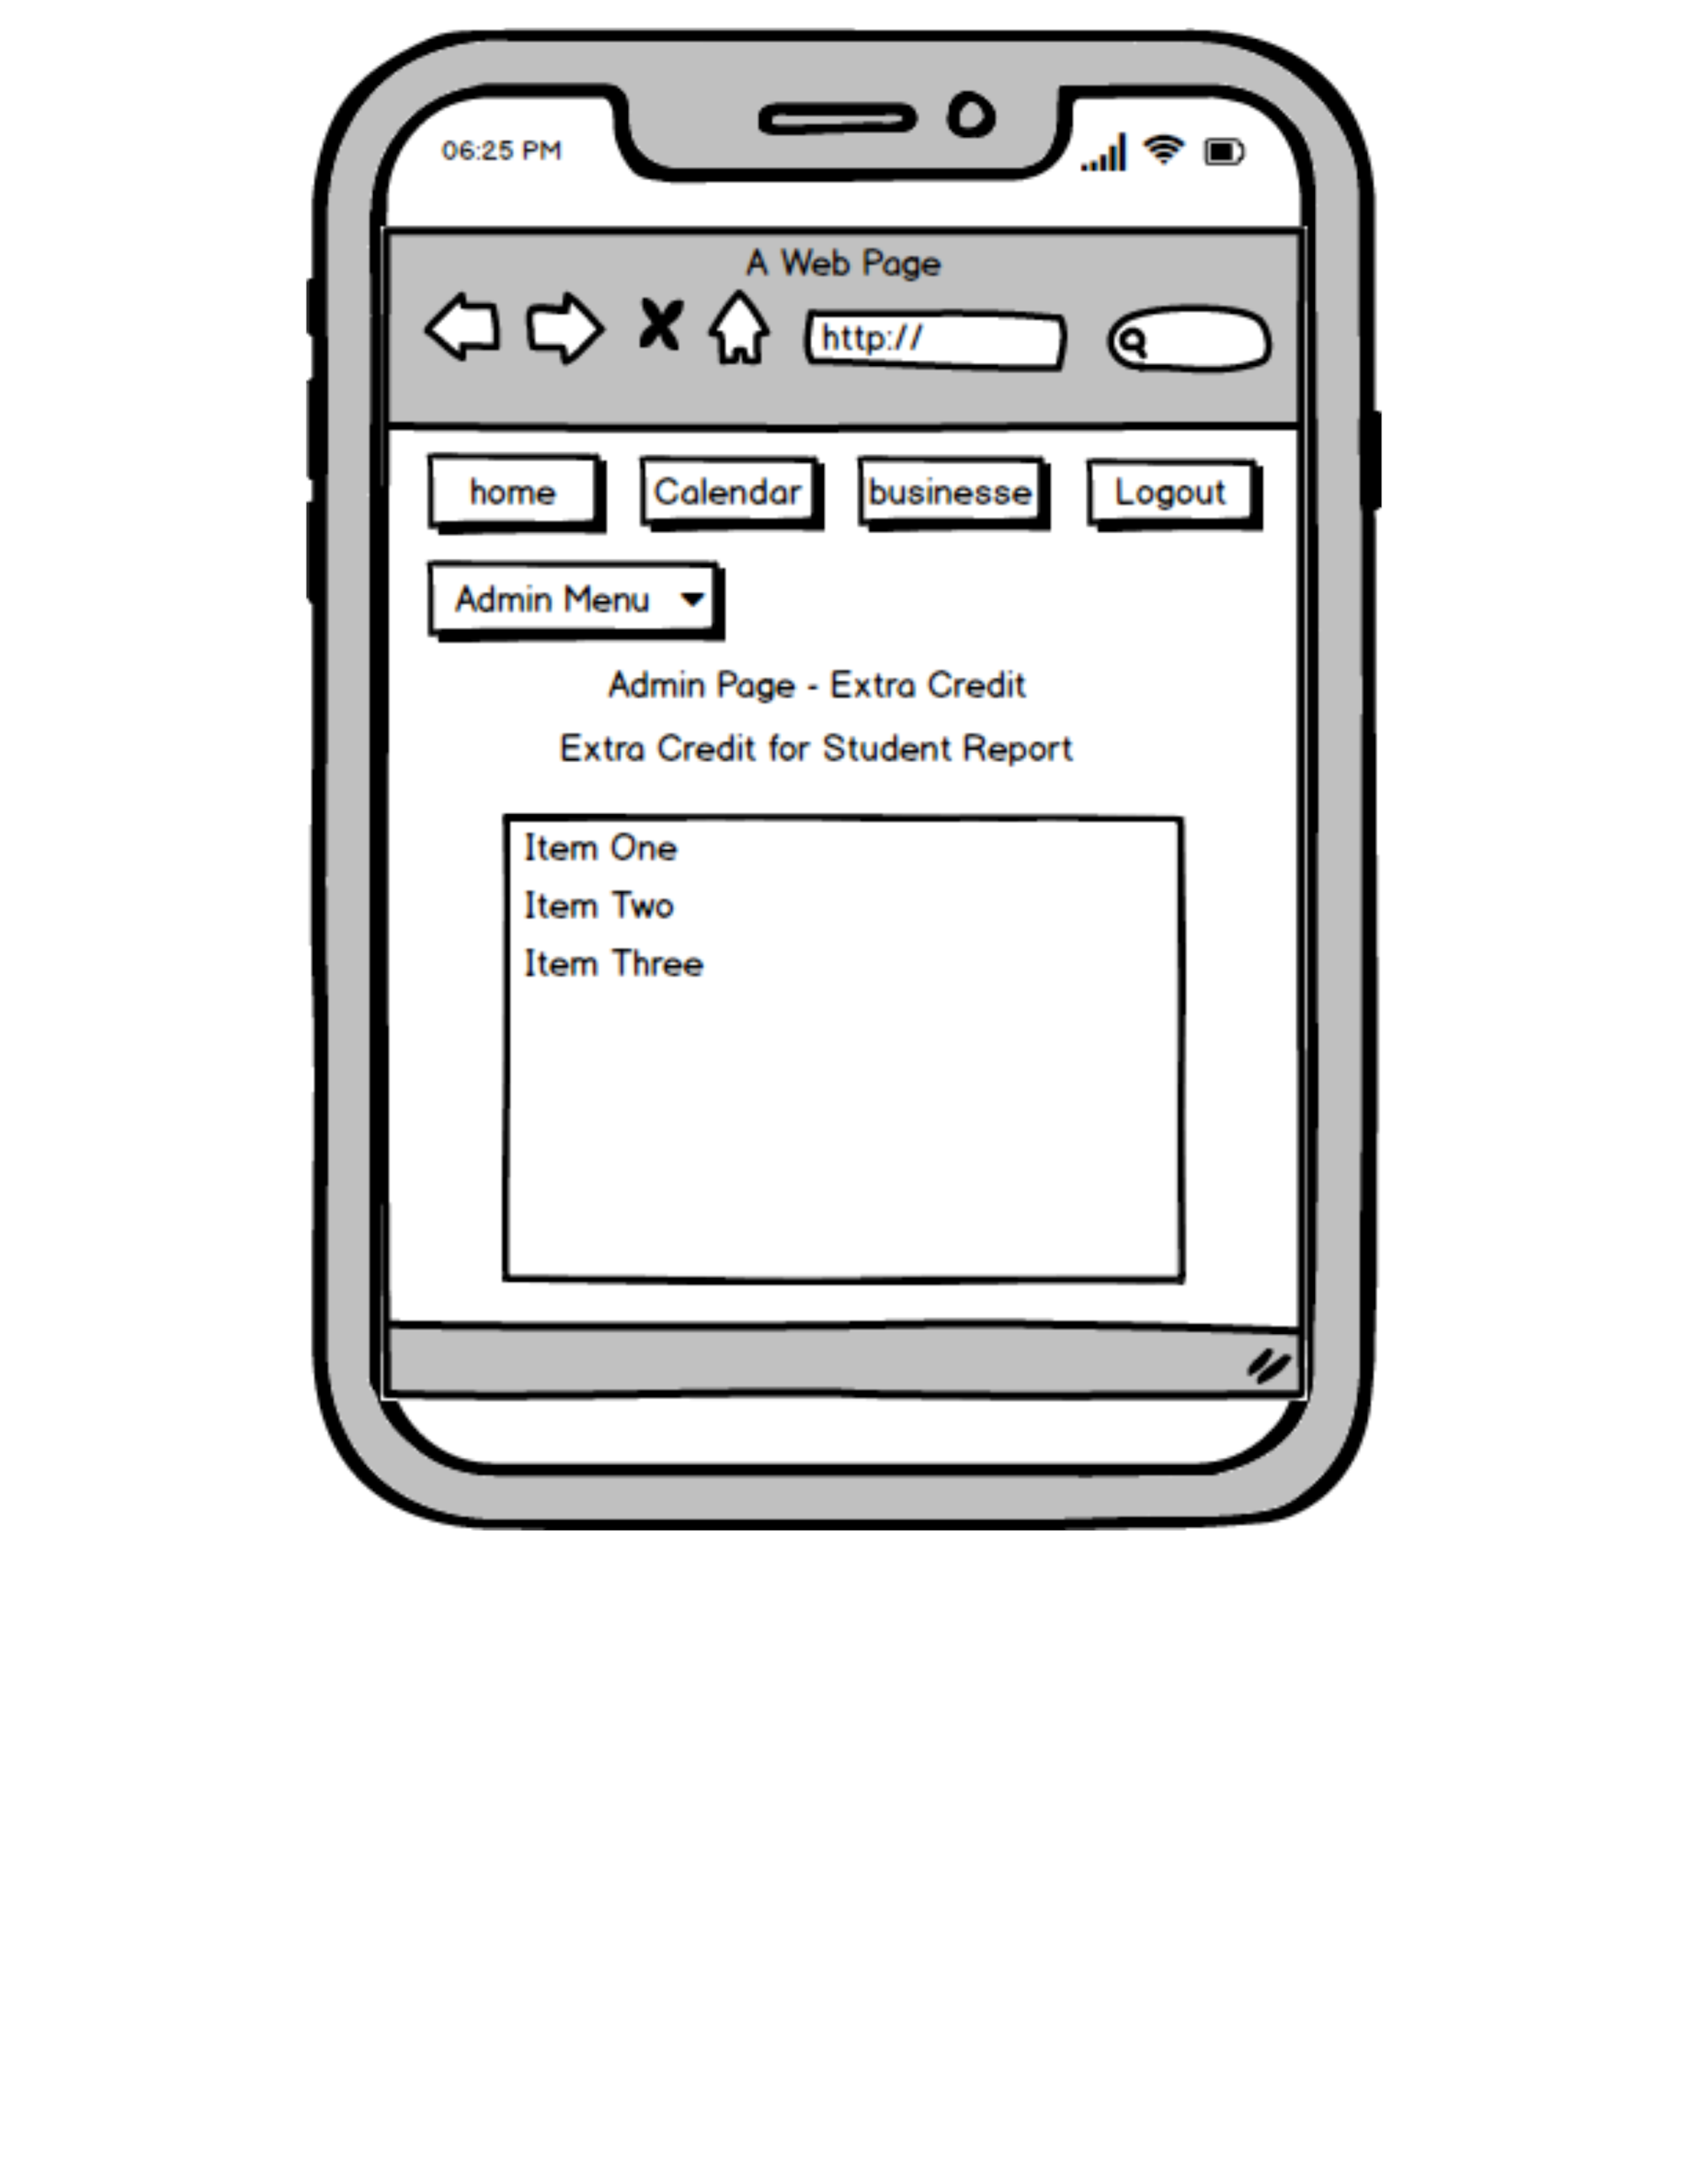
Mobile 9

Slide 23
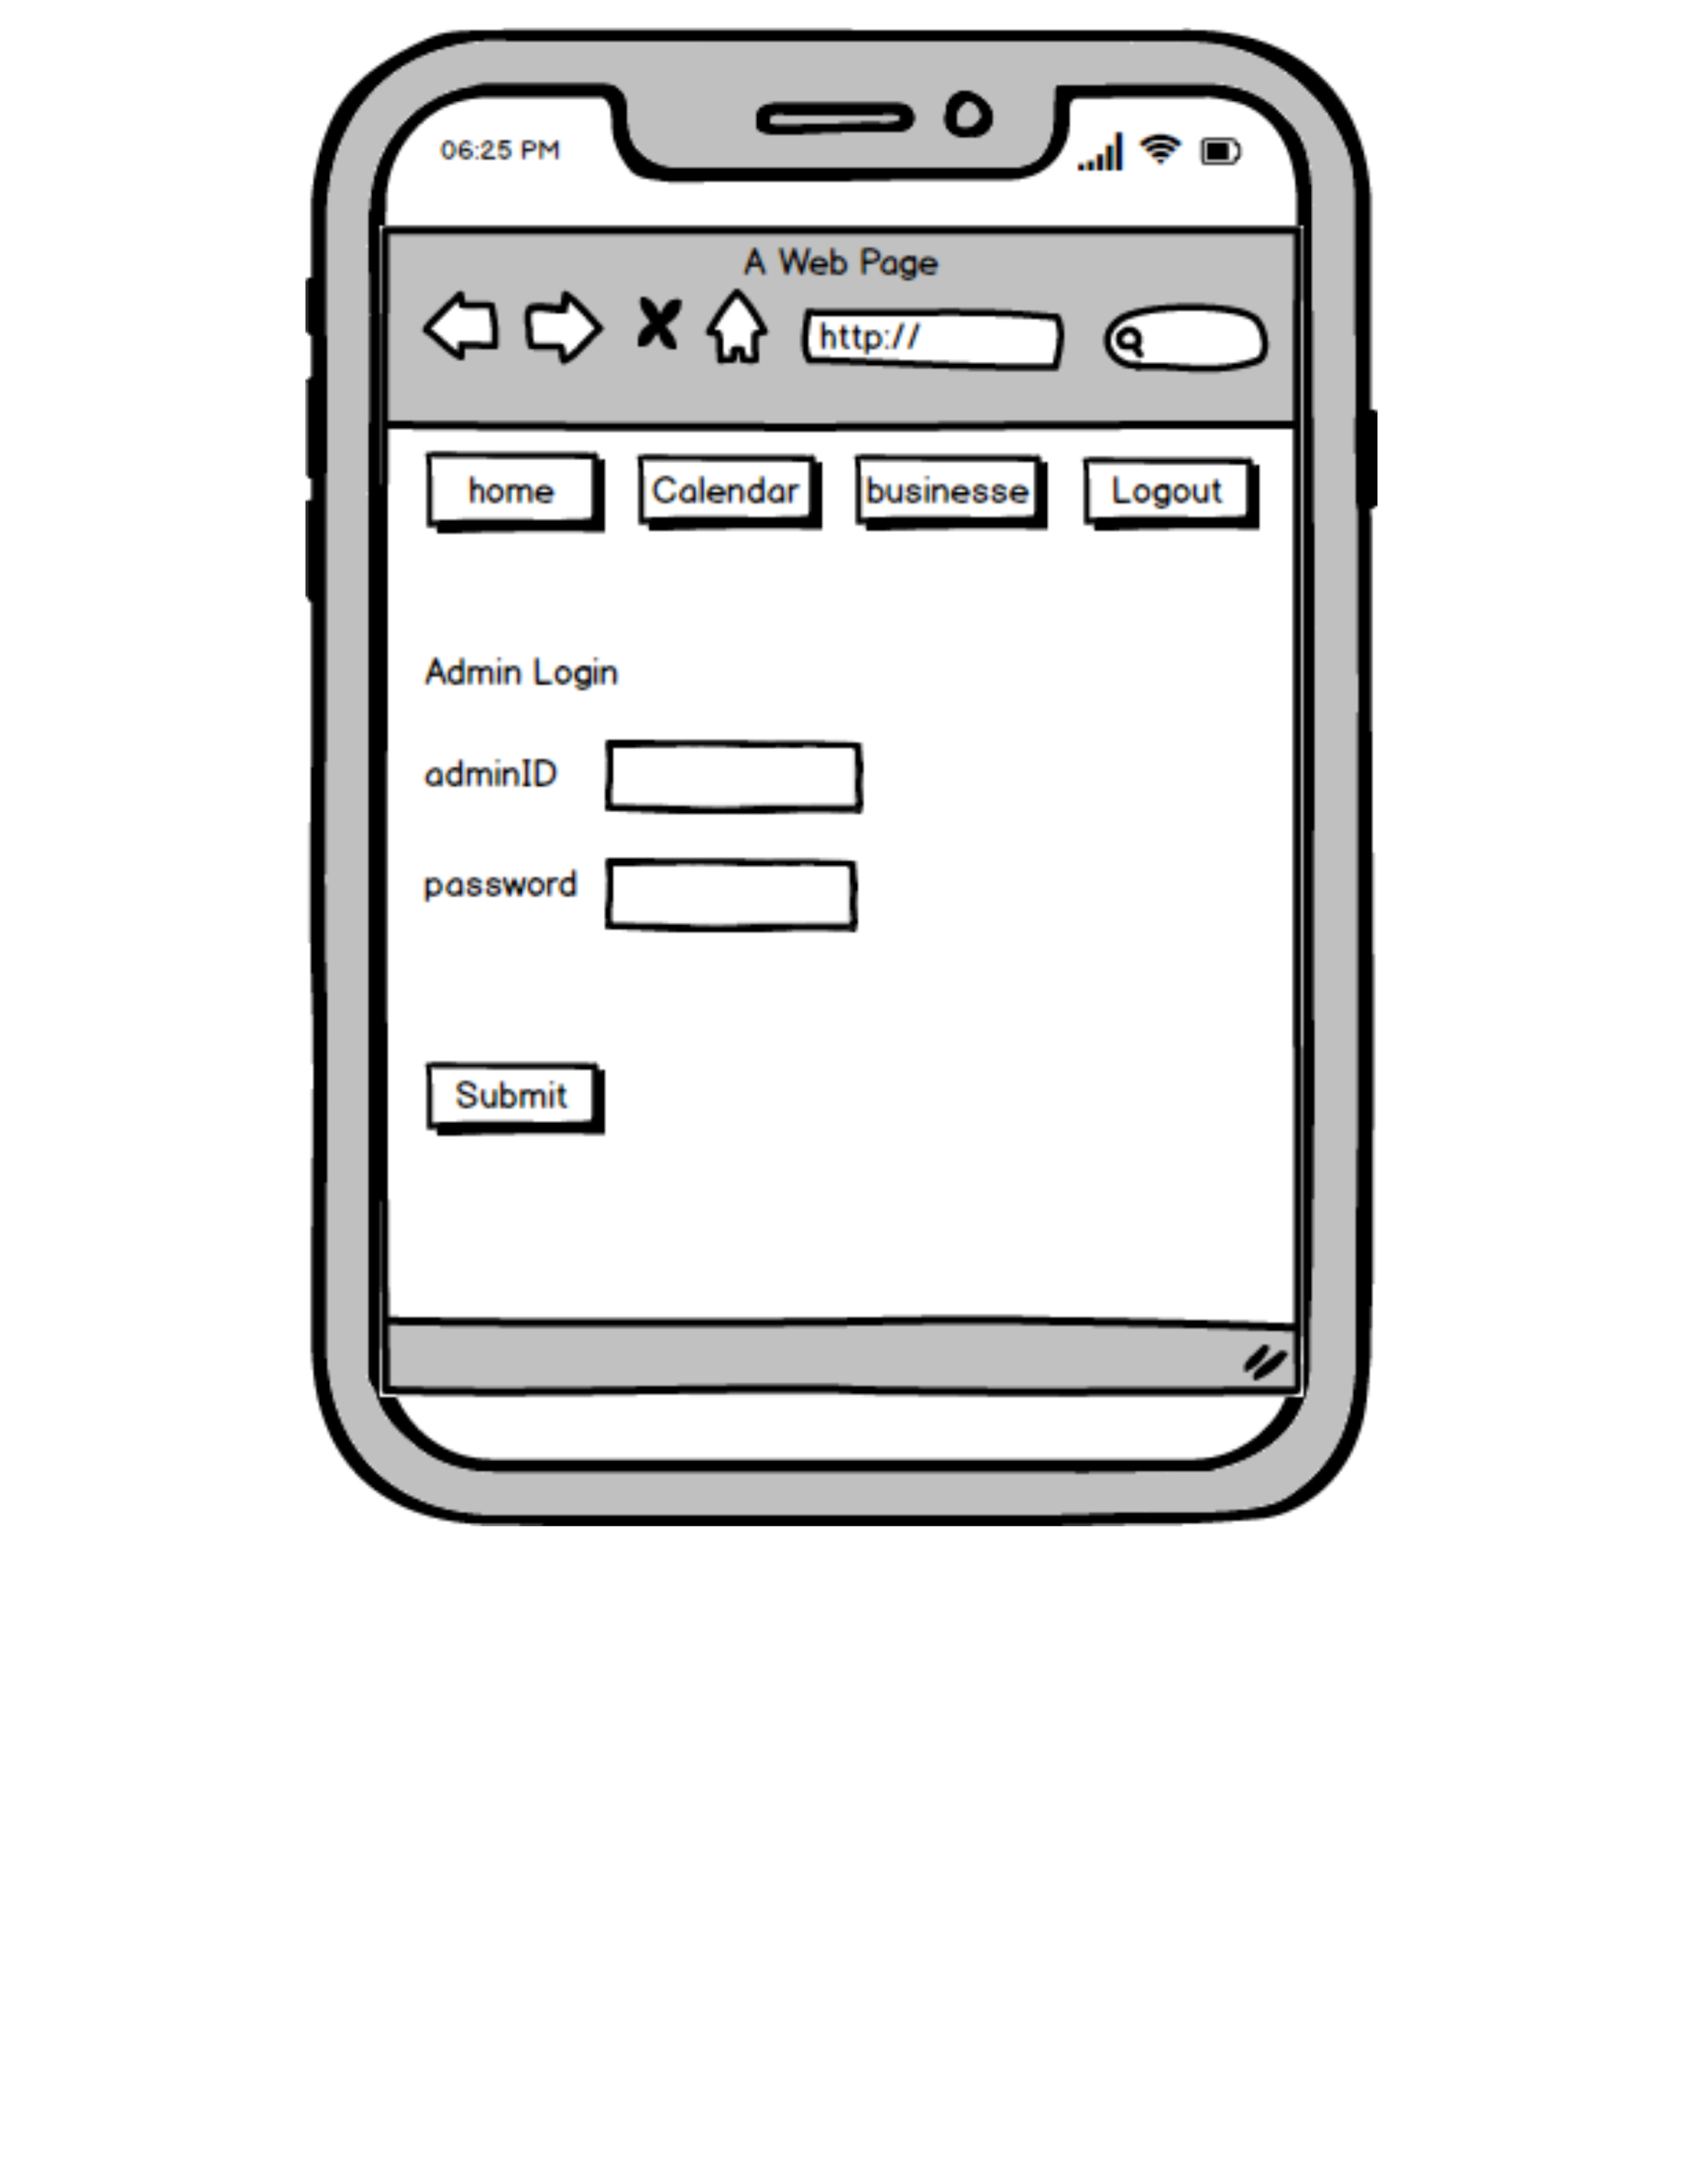
Mobile 10

Slide 24

Mobile 11

Slide 25
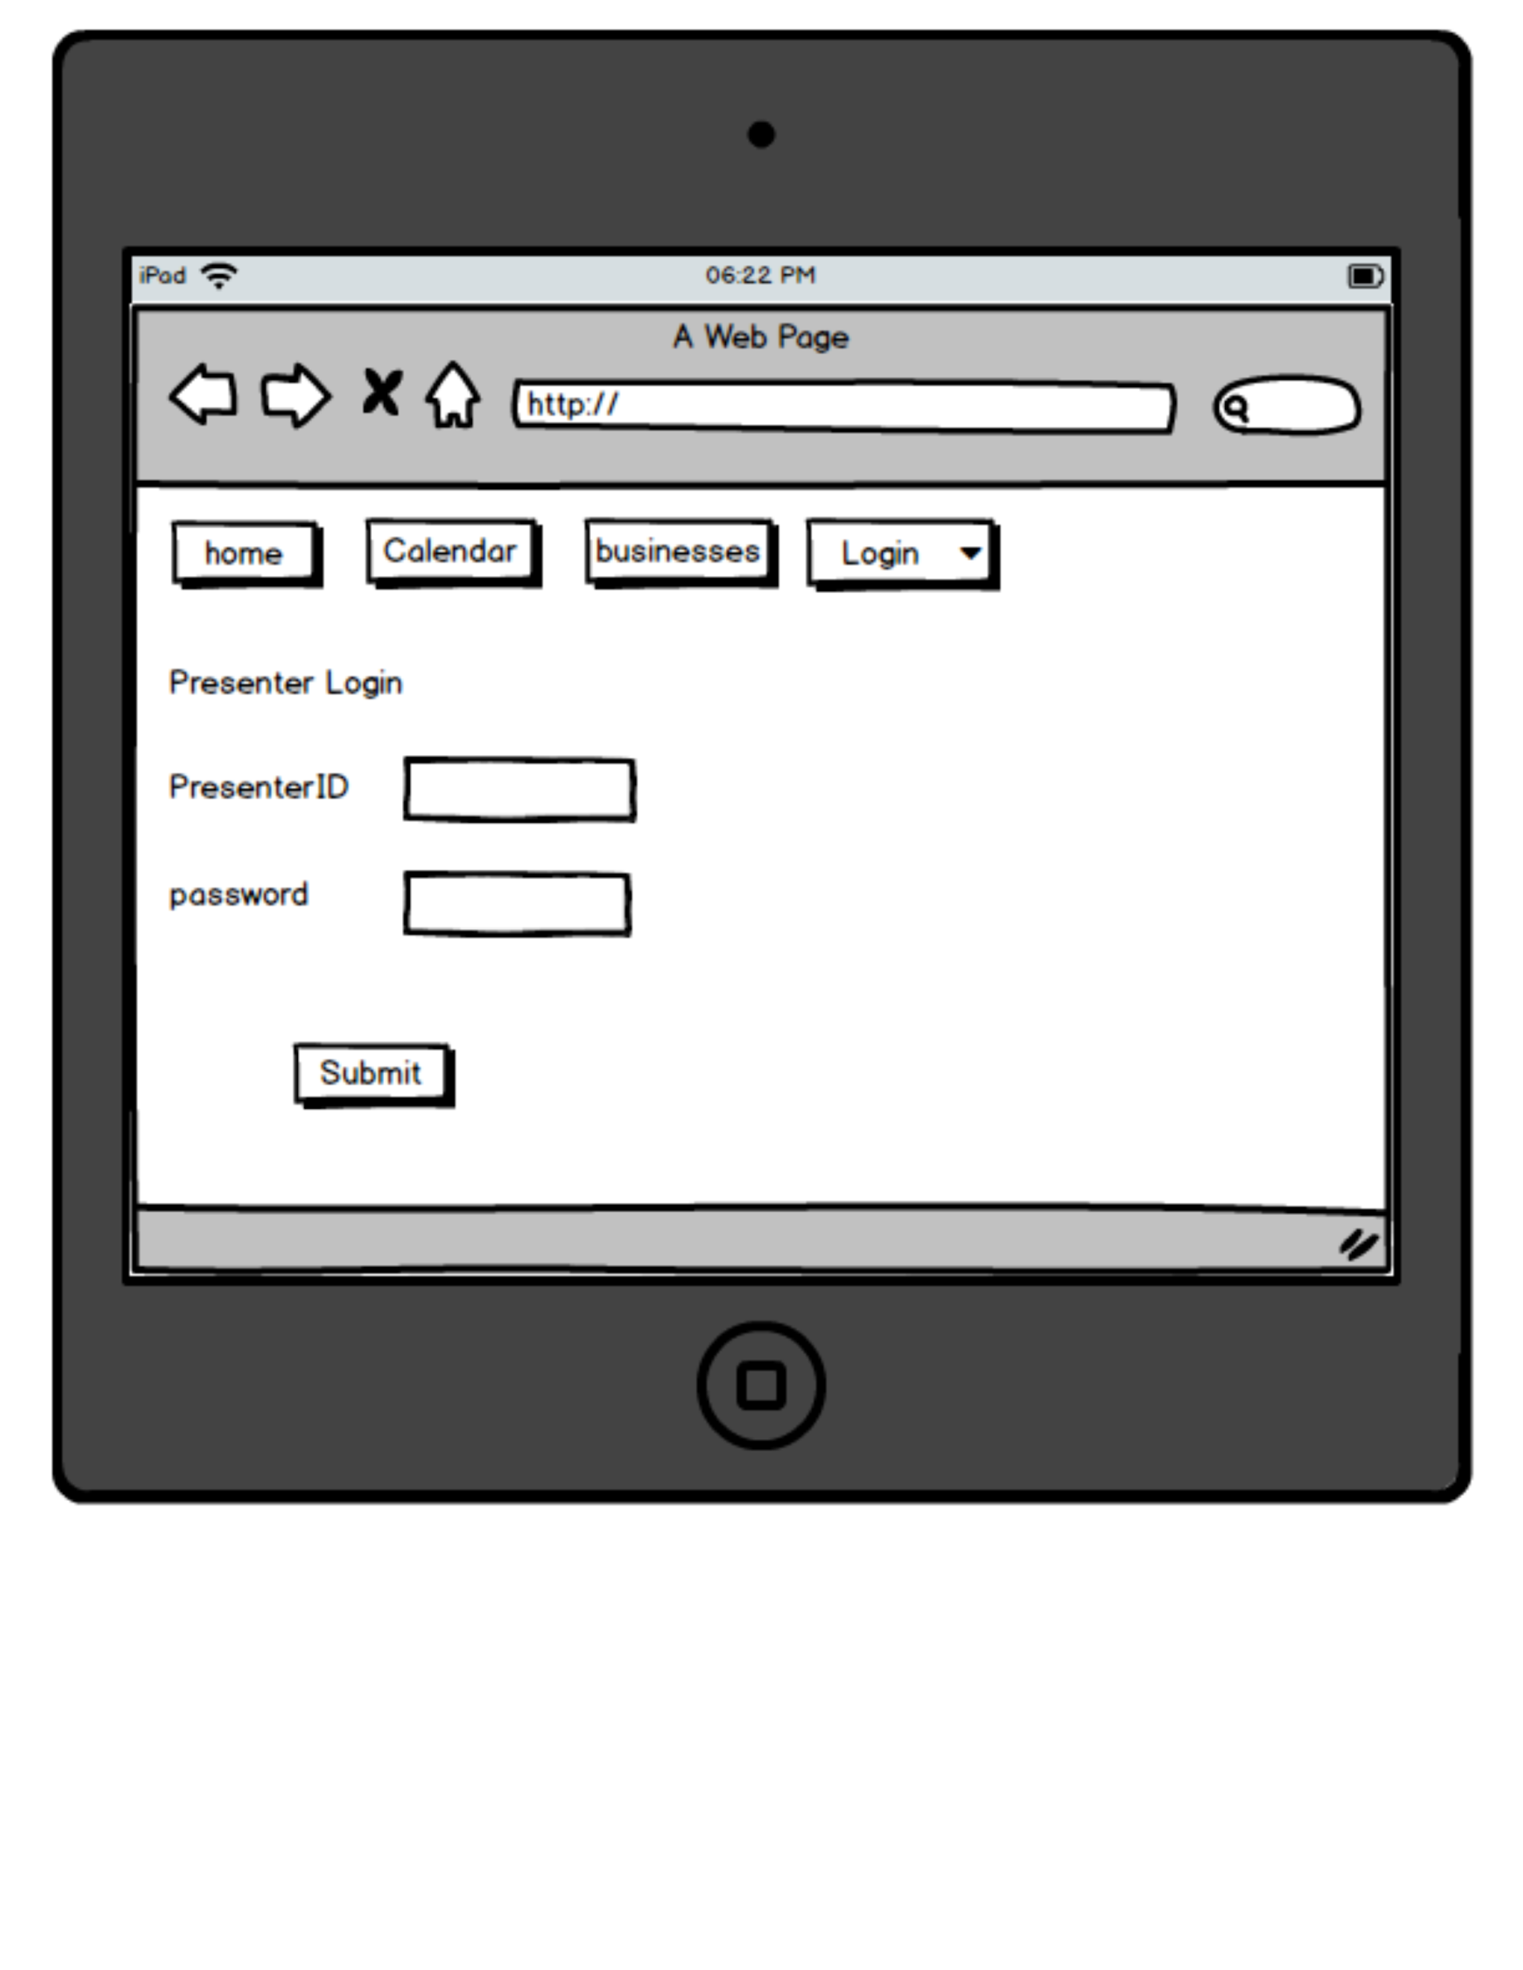
Tablet 1

Slide 26

Tablet 2

Slide 27

Tablet 3

Slide 28
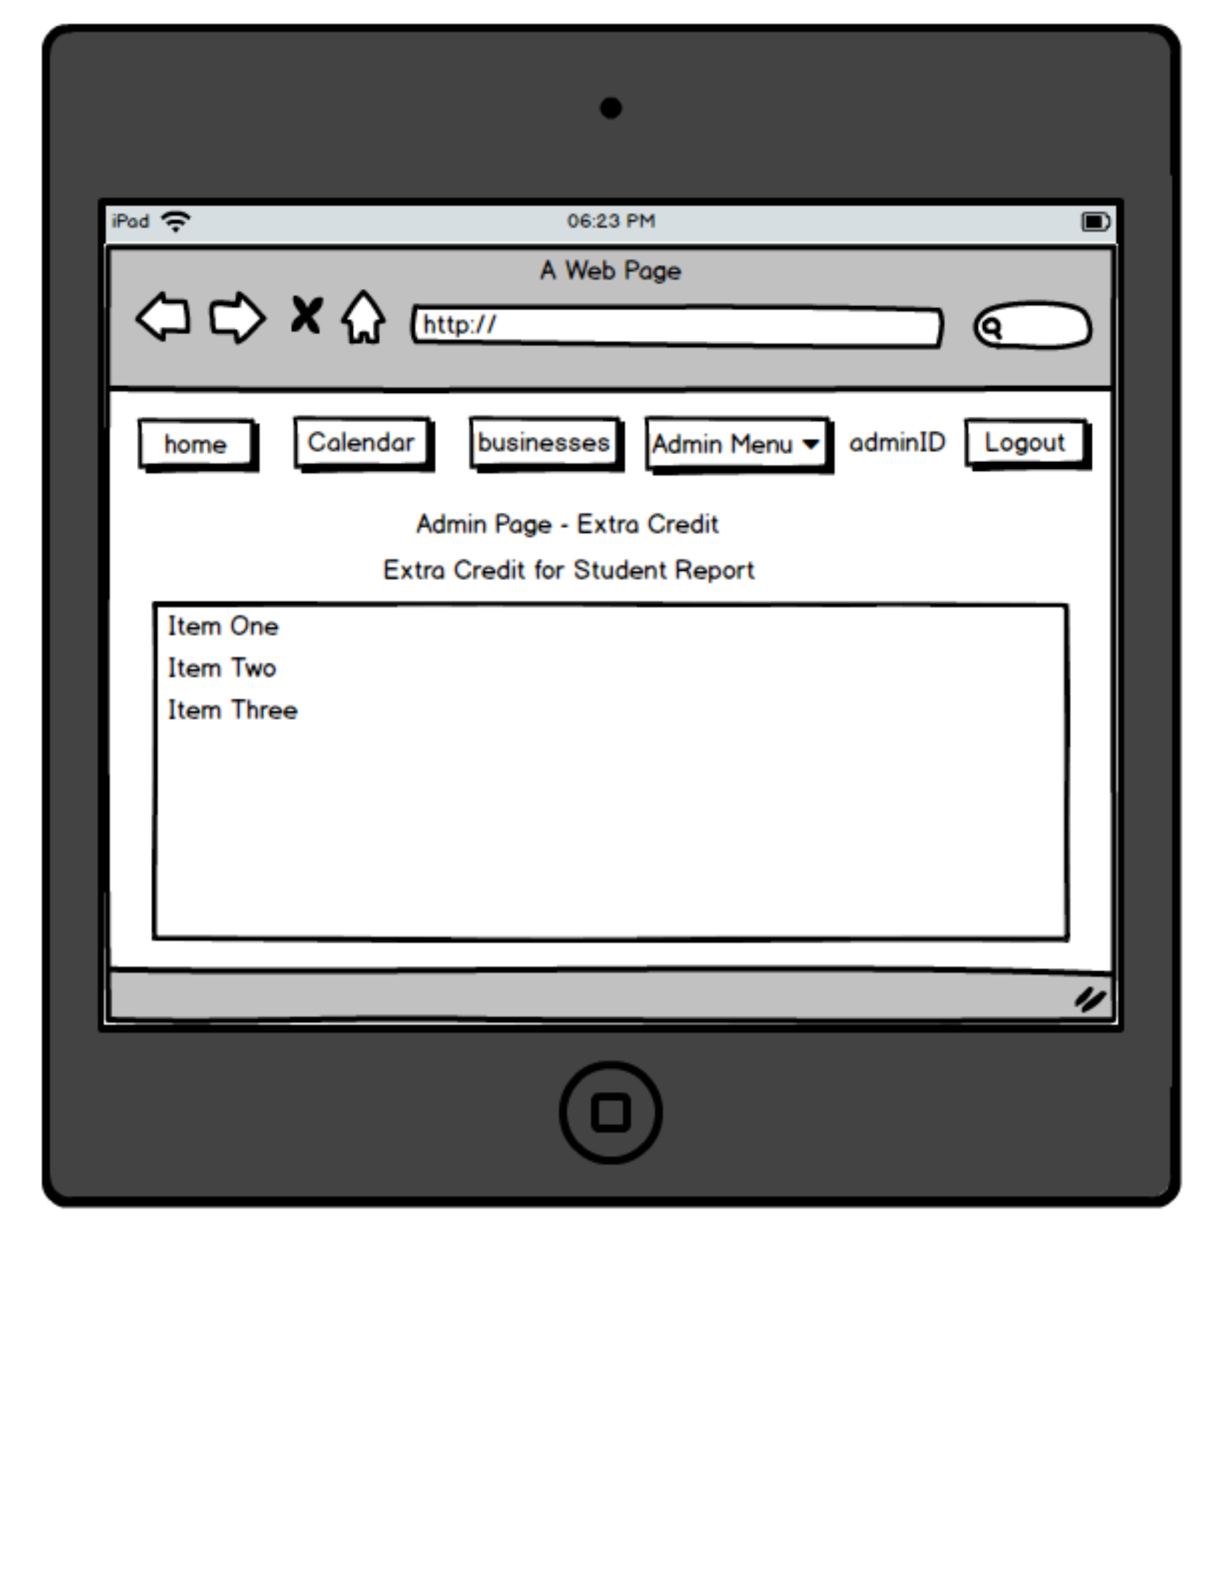
Tablet 4

Slide 29
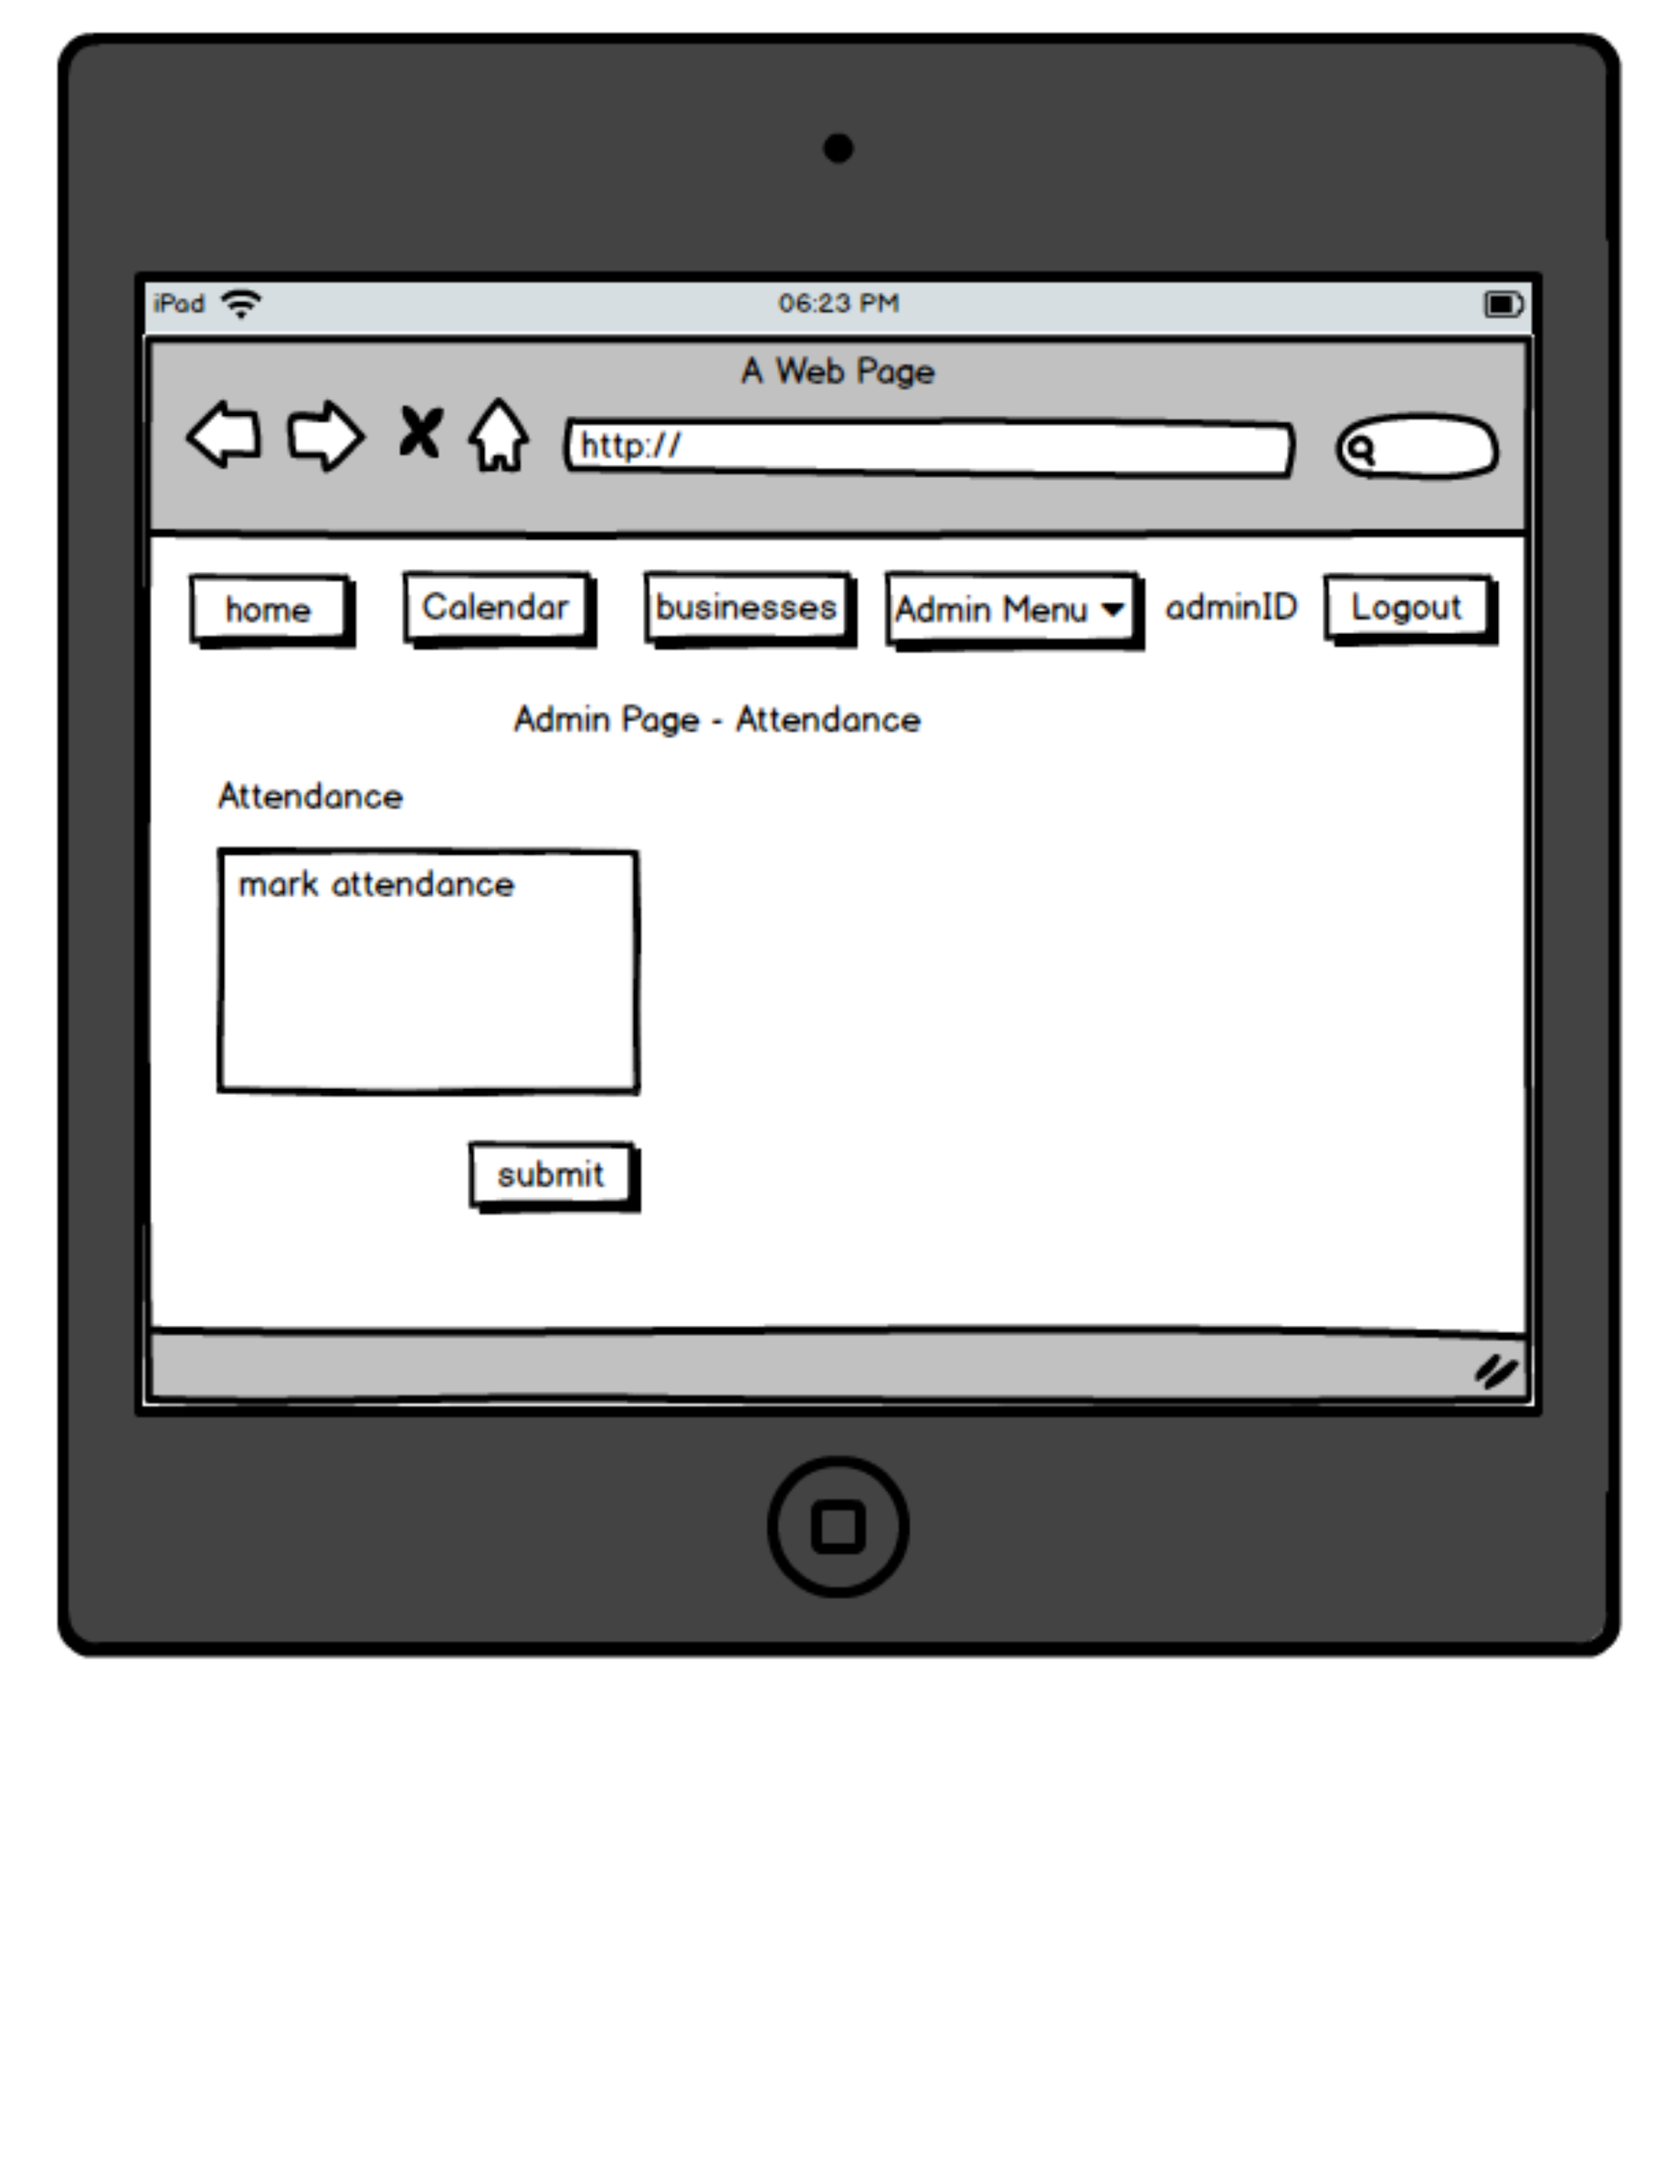
Tablet 5

Slide 30
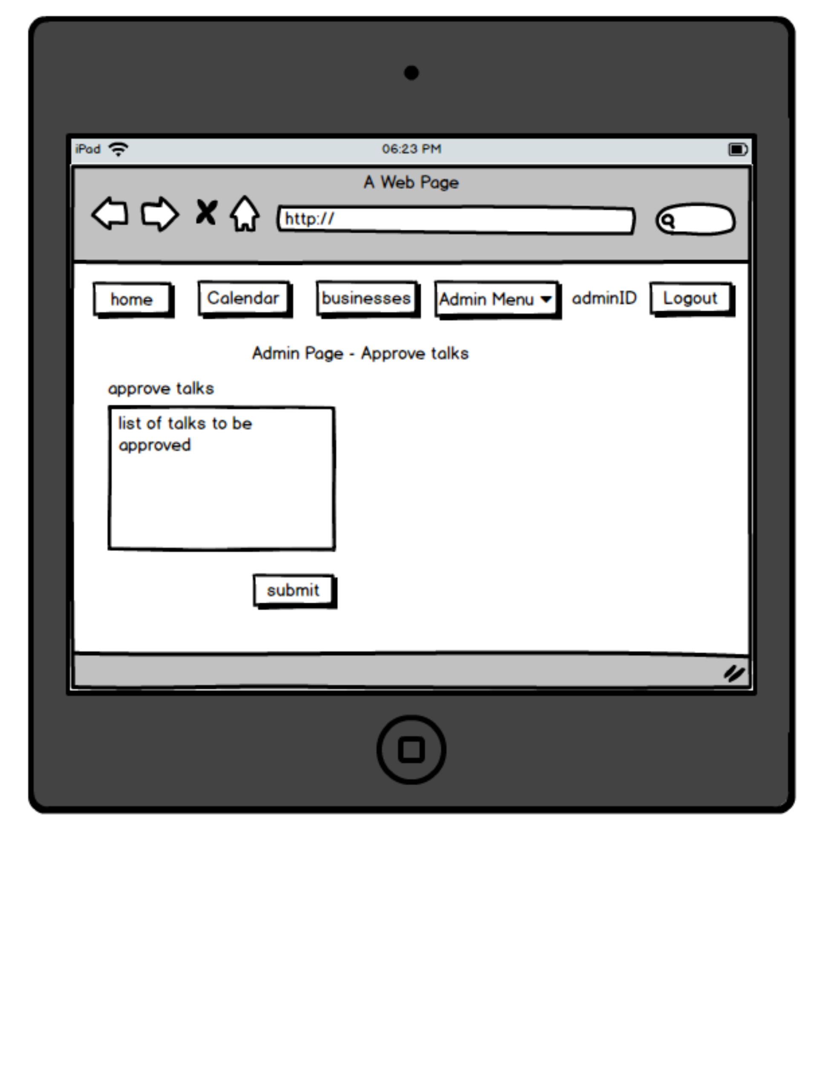
Tablet 6

Slide 31
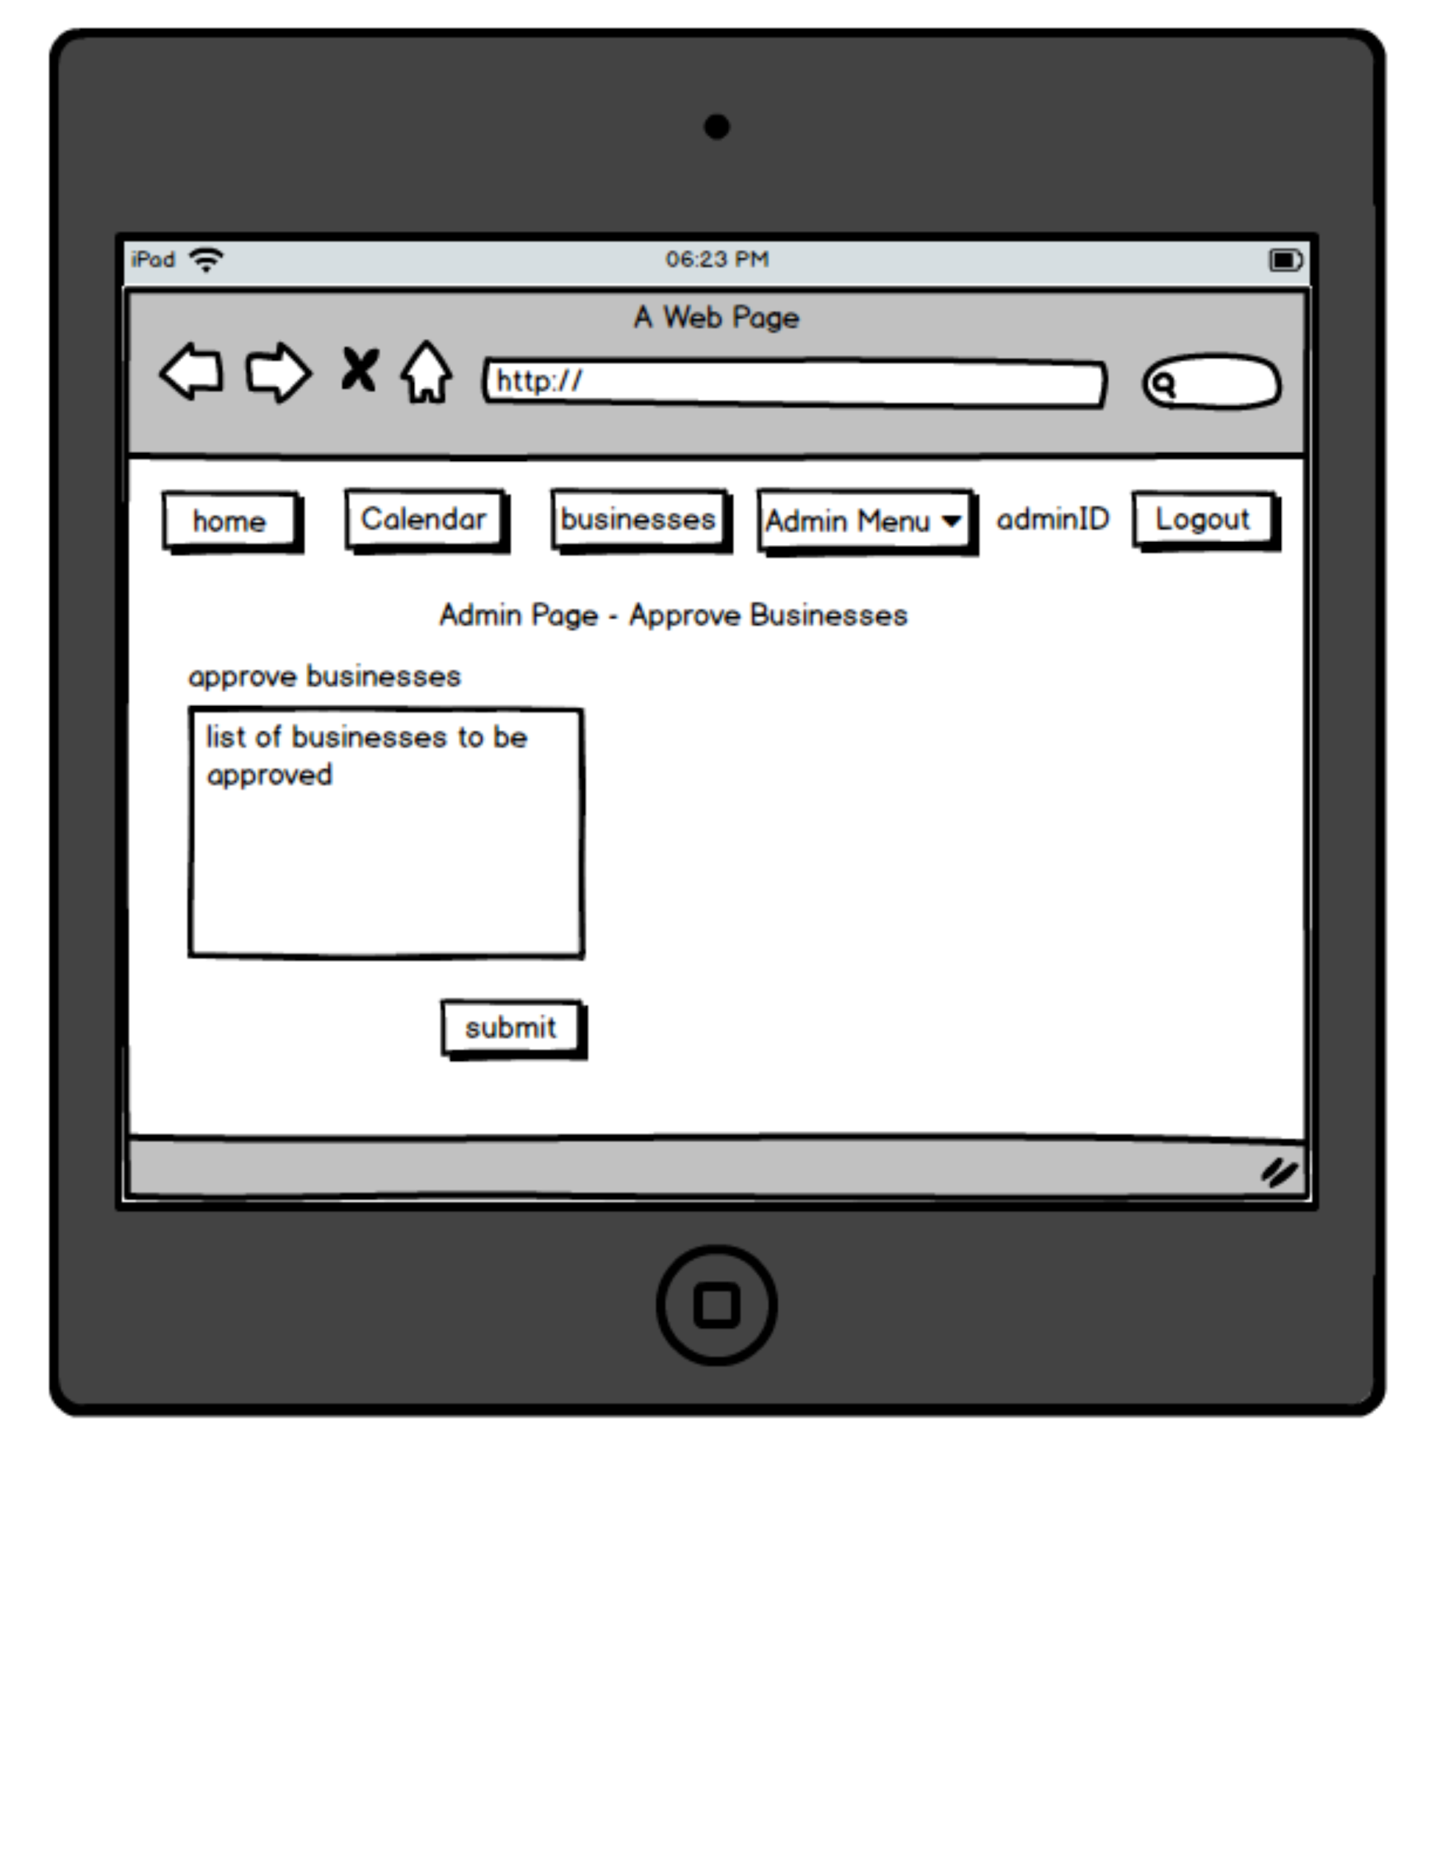
Tablet 7

Slide 32
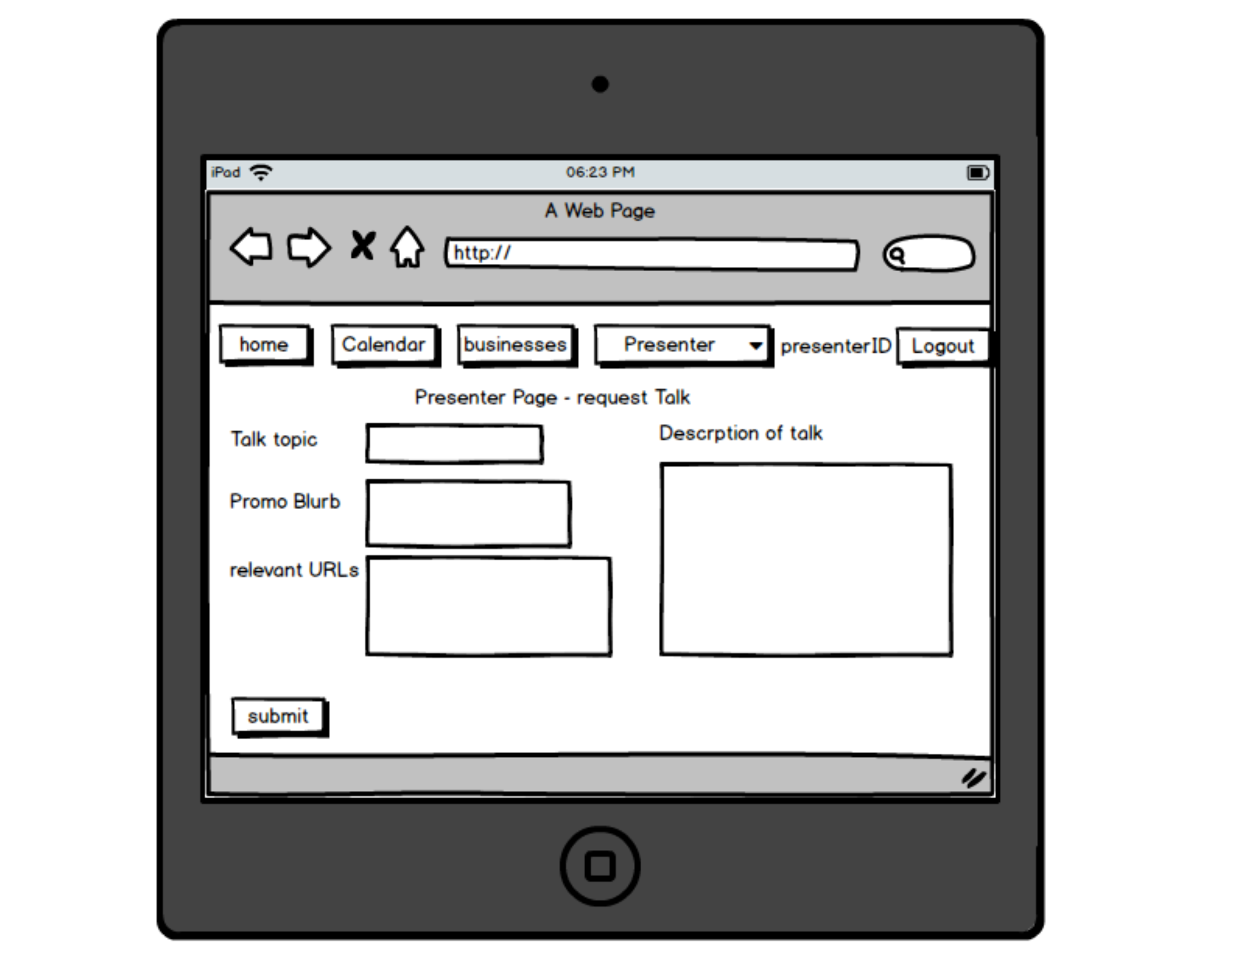
Tablet 8

Slide 33
Tablet 9

Slide 34
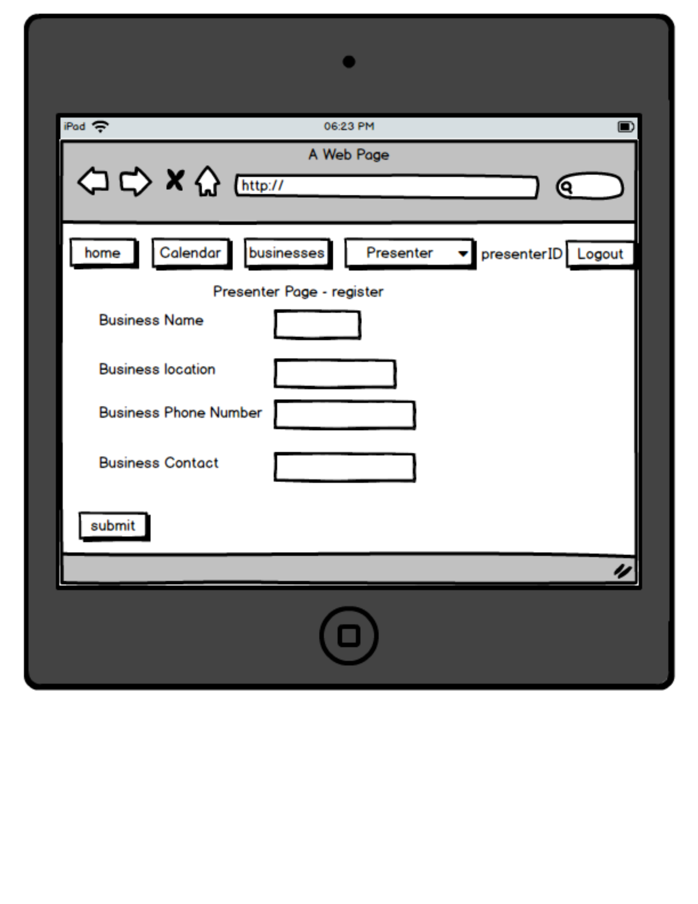
Tablet 10

Slide 35
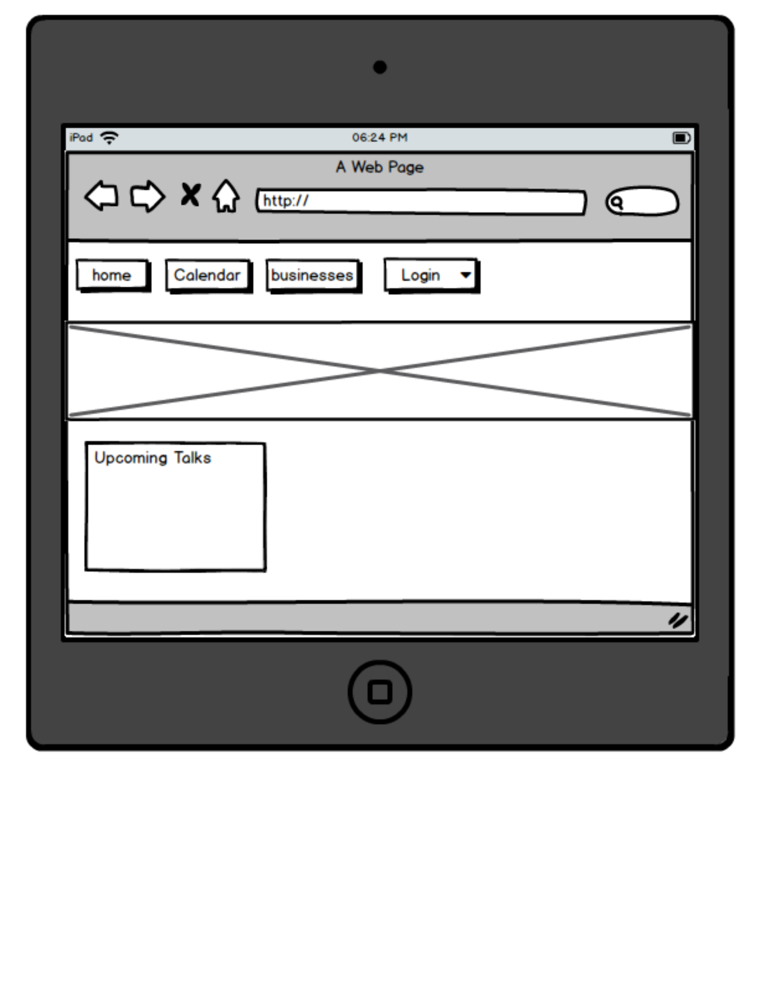
Tablet 11

Slide 36
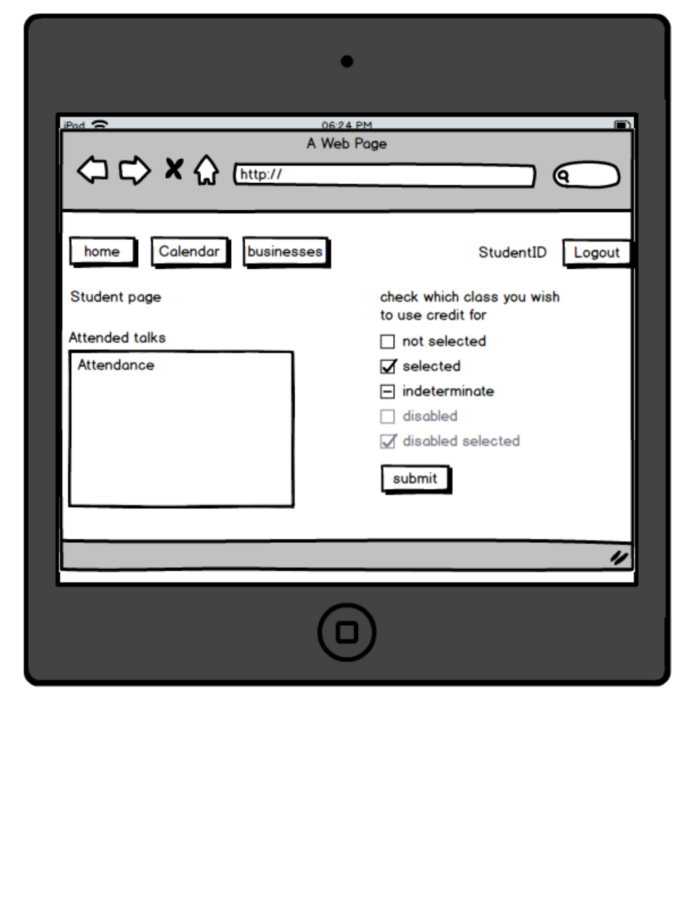
Tablet 12

